Slide 1

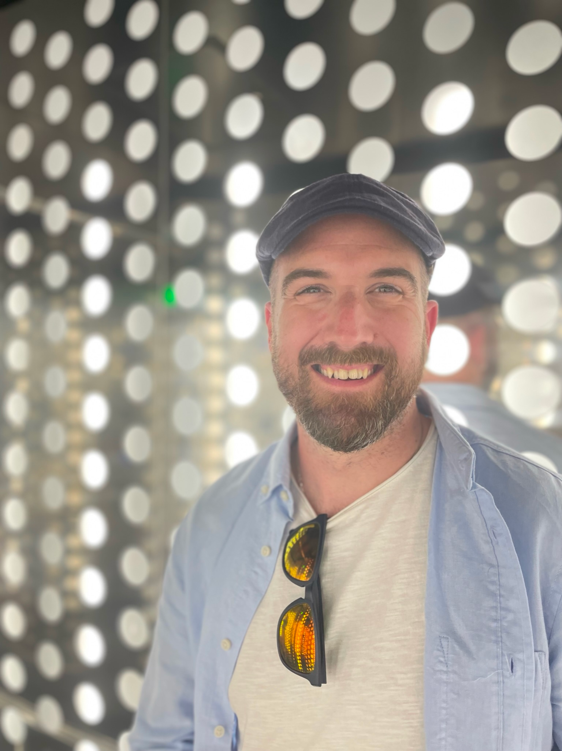
Psychological Safety: Lessons from Healthcare and Aviation
Tom Geraghty
tom@psychsafety.com
Notes:
In this talk, we examine why people don't speak up, even when lives are at risk. Drawing on insights from healthcare and aviation, we'll uncover valuable lessons as well as some practical things to do in our own work.
(Not sure which image to use, will choose one)

Slide 2
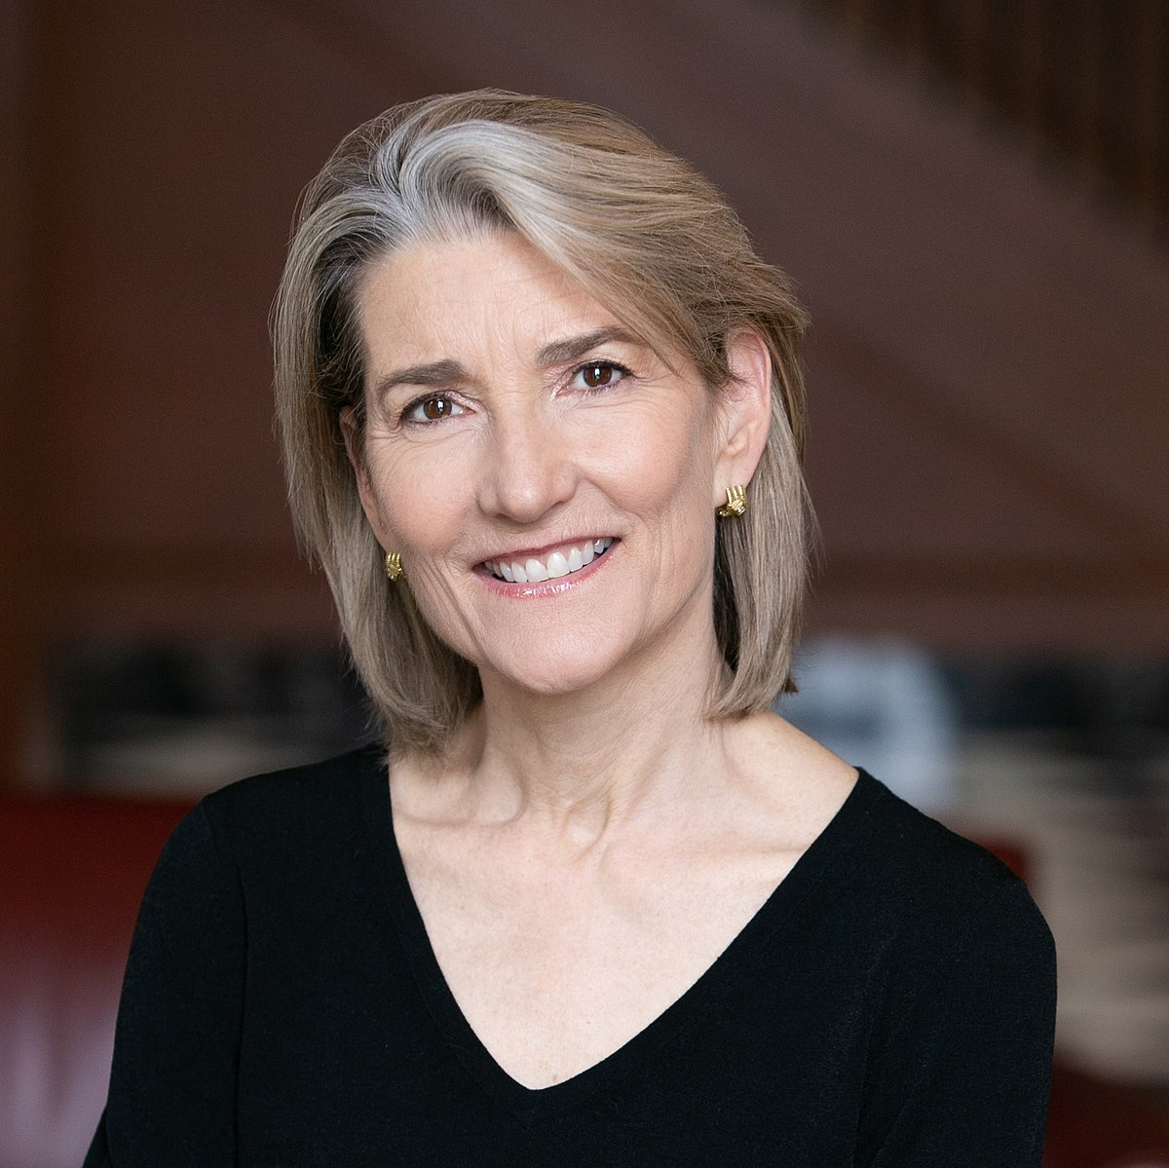
Psychological Safety
“Psychological safety is a belief that one will not be punished or humiliated for speaking up with ideas, questions, concerns, or mistakes.”
“A shared belief held by members of a team that the team is safe for interpersonal risk-taking.”
Dr Amy Edmondson, Photo credit Evgenia Eliseeva, Creative Commons
2
Dr Amy Edmondson, Psychological Safety and Learning Behavior in Work Teams, 1999
Notes:
Project aristotle?

Slide 3
When people feel psychologically safe, you might hear:
I don’t know, yet.
I need help.
I have an idea.
I think we have a problem.
I disagree.
I’d like to challenge that.
It’s ok, we can learn from this.
I made a mistake.
I made a really big mistake.
3

Slide 4
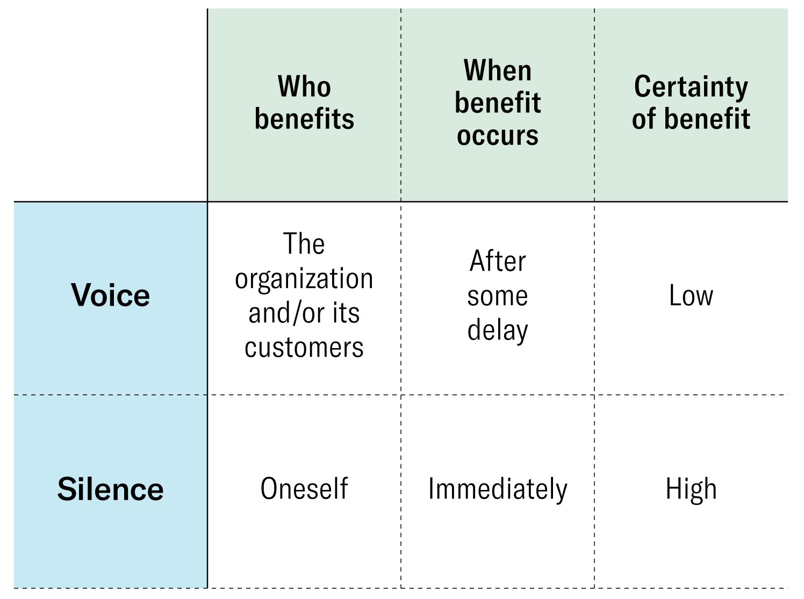
The Mental Cost Benefit Calculation
Fear that asking for help means you don't know what you're doing
Loss of status with your friends, peers, or boss
Fear of punishment
Missing out on promotions or opportunities
Missing out on bonuses
Fear of being criticised
Concerned that it could mean more work to do
Don't want to be labelled as a problem person
Don't want to cause trouble
Don’t want to make your boss angry
Feel you're not expert enough to suggest an idea
Fear that you’re *too* expert to ask for help
Fear that it won’t come out right
4
Dr Amy Edmondson, The Fearless Organisation

Slide 5
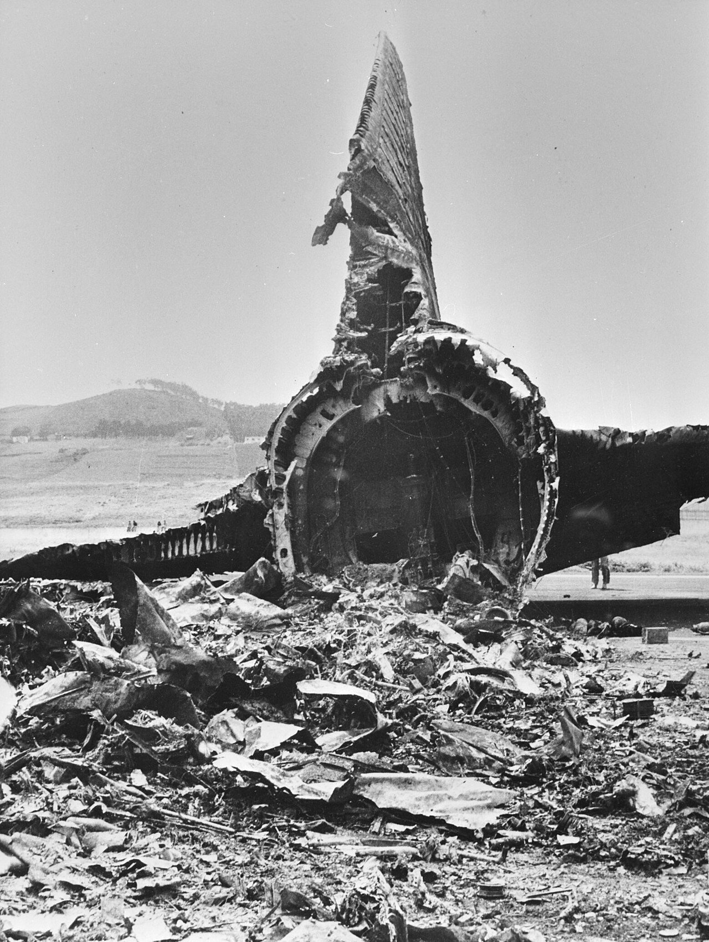
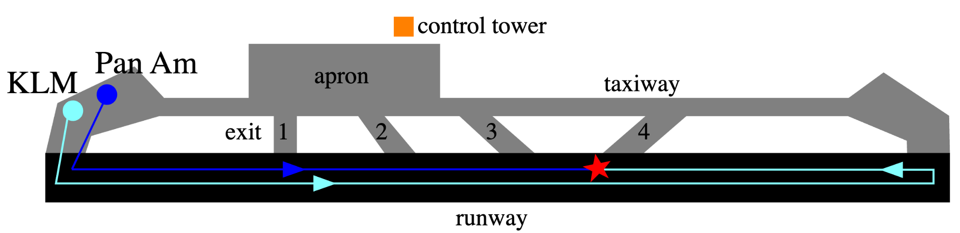
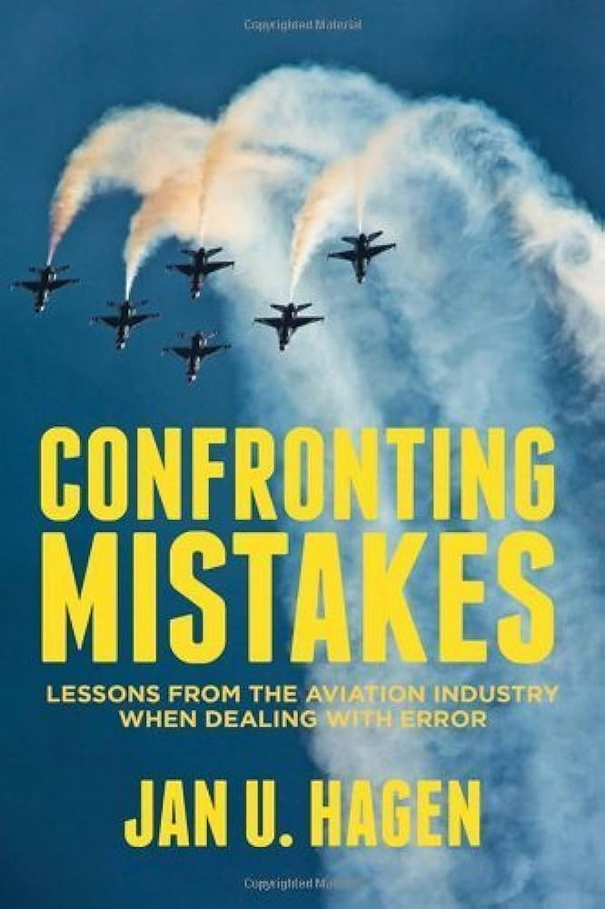
Tenerife, 1977
Flight crew
Captain Jacob van Zanten: 11,000 flight hours
First Officer Klaas Meurs: 9,200 flight hours
Flight Engineer Willem Schreuder: 17,031 flight hours
Notes:
Disasters caused in part by a lack of psychological safety - examples
Today - Tenerife
Niall Downey
Experienced crew
Captain Van Zanten - chief instructor and safety officer, poster boy for KLM’s punctuality, and the person who just promoted Meurs to first officer
Multiple factors resulted in two aircraft on the runway at the same time - a Pan Am 747 and a KLM 747. (incidentally, the KLM one was the first 747 to be
Time pressures meant van Zanten really wanted to get in the air.
Miscommunication and other errors meant he didn’t know the Pan Am was on the runway - they’d been asked to take exit 3 off the runway but it was too tight.
Van Zanten started to go, but Meurs informed him they didn’t have clearance for takeoff, so Van Zanten told him to get it. Halfway through Meurs getting it, Van Zanten said “we’re going” and throttled the engines.
Schreuder asked “Is he not clear then?” referring to the Pan Am, and Van Zanten replied “Oh yes!” and carried on.
The two planes collided on the runway, killing everyone on board the KLM flight, and most on board the Pan Am. It was the deadliest disaster in aviation history.
Whilst there are many compounding factors, the investigations that followed all show that the power dynamic between the KLM captain (van zanten) and his crew meant they did not speak up and challenge him when they both clearly had concerns.
The disaster could have been avoided if either flight crew member had felt psychologically safe to challenge the captain - the man who was chief instructor, head of safety, and held their careers in his hands.
The outcome of this for the aviation industry was CRM - cockpit resource management or crew resource management. And it’s the most successful safety programme in the world - adopted by every airline in every country, and continually evolving. It primarily focuses on creating the environments for safe, clear and effective communication, and ensuring that everyone feels comfortable challenging the actions and decisions of others, even those very senior to them.
And that’s what every leader should be doing, not just in aviation.
We need to recognise the incredibly strong effect of interpersonal fear - that even when lives are at stake, people may not speak up boldly and clearly due to fear of humiliation, embarrassment, punishment or other consequences.
Captain Jacob Louis Veldhuyzen van Zanten was a living legend at KLM, the face of the airline’s advertising campaign and the head of its Boeing 747 training program. These days, he spent most of his time training new pilots, and the trip to the island of Gran Canaria would be his first regular line flight in twelve weeks. His First Officer, Klaas Meurs, was also no rookie, but he had only just upgraded to the 747, accumulating a mere 95 hours since acquiring his type rating, which Captain van Zanten had personally granted to him.
cockpit hierarchies were dangerously one-sided. The prevailing culture was one of deference to the captain, in which junior crewmembers did not feel empowered to assert themselves if they thought the captain was making a mistake. In the case of the Tenerife disaster, this manifested in the form of self-doubt that prevented the First Officer and Flight Engineer from fully exploring or articulating their own concerns, laboring under a mistaken assumption that the Captain had a better understanding of the situation than they did.
On the KLM, Flight Engineer Schreuder, having overheard the conversation between the Pan Am and the tower, said, “Is he not clear then?”
“What did you say?” asked Captain van Zanten.
“Is he not clear, that Pan American?” Shreuder repeated.
“Oh yes!” van Zanten emphatically replied. The 747 continued to accelerate, barreling directly toward the Pan Am jet still searching for the fourth exit.

Slide 6
Graded Assertiveness:
P.A.C.E. (Probe, Alert, Challenge, Emergency)
Probe – “Are you feeling rested enough to do this journey?”
Alert – “I’m concerned that you might be too tired to complete this journey safely.”
Challenge – “Wait. I don’t think this is safe.”
Emergency – “STOP. You’re not safe to drive.”
Notes:
As leaders, what can we do?
Speaking up has a cost, but it also has a reward - “is it safe, and is it worth it” is the calculation we all do, every time we speak up. We’re going to look at a very good example of a success of that in the workplace.

Slide 7
Takeaways
Make psychological safety a priority.
Decrease the cost & increase the benefit of speaking up.
Model psychologically safe behaviour.
7

Slide 8
Thanks!
Tom@psychsafety.com
Check out our newsletter, resources, community and events at psychsafety.com
Notes:
As leaders, what can we do?
Speaking up has a cost, but it also has a reward - “is it safe, and is it worth it” is the calculation we all do, every time we speak up. We’re going to look at a very good example of a success of that in the workplace.

Slide 9
Appendix
tom@psychsafety.com Iterum Ltd

Slide 10
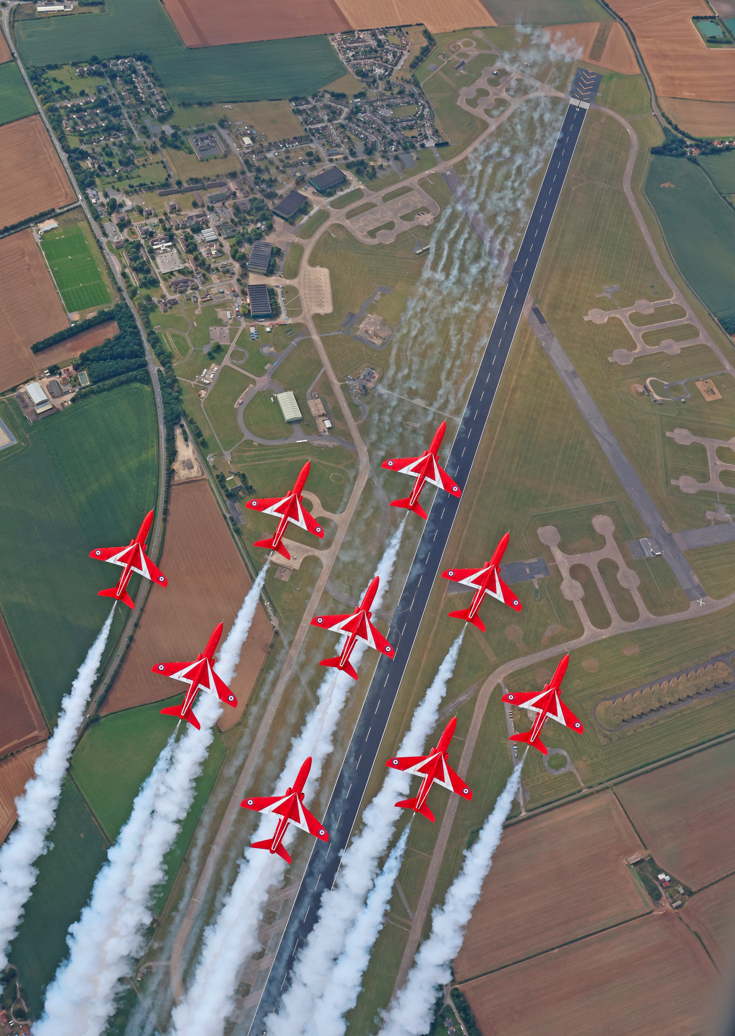
Admitting mistakes
Notes:
As leaders, what can we do?
Speaking up has a cost, but it also has a reward - “is it safe, and is it worth it” is the calculation we all do, every time we speak up. We’re going to look at a very good example of a success of that in the workplace.

Slide 11
