Slide 1
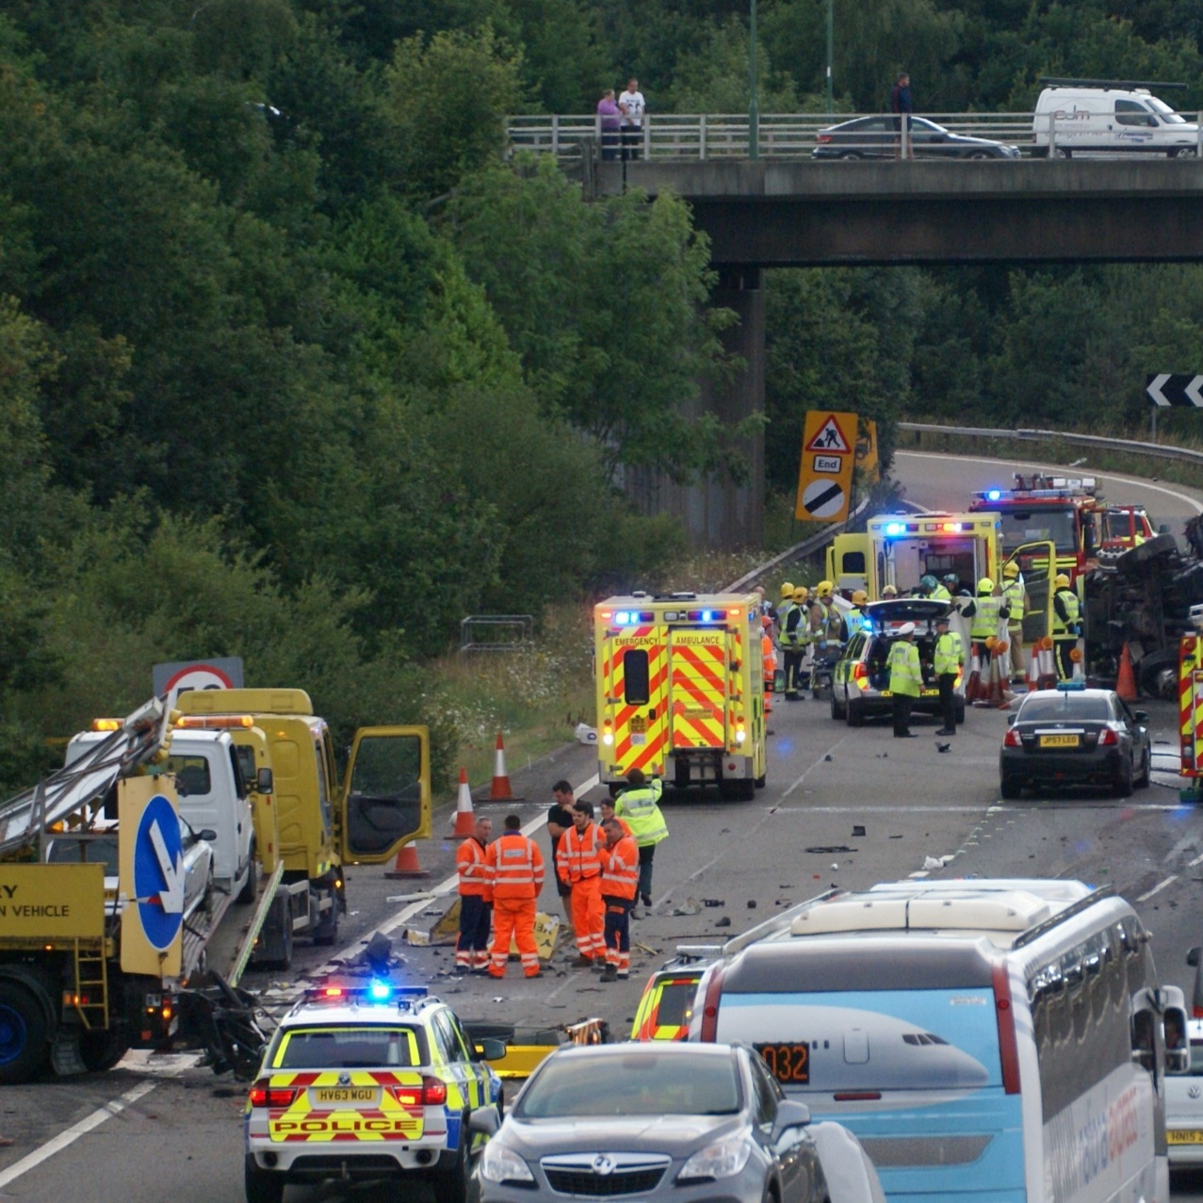
Collision Review Boards
The Safe System Approach
Saul Jeavons
Director, The Transafe Network

Slide 2
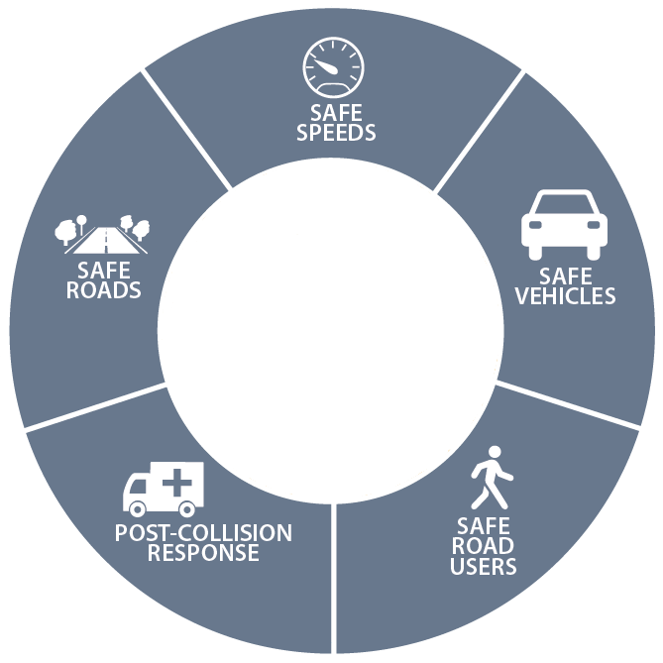

“No human being should be killed or seriously injured
as the result of a road crash”

Slide 3
Incident Investigation – where does it fit?
Incidents
Investigations
Interventions
The Traditional Industry Model

Slide 4
Incident Investigation – where does it fit?
Incidents
Investigations
Data
Interventions
The Traditional Road Safety Model

Slide 5
Incident Investigation – where does it fit?
Incidents
Investigations
Data
Interventions

Slide 6
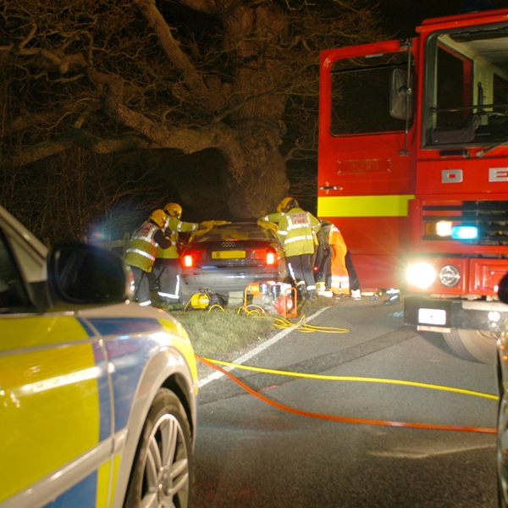
Collision Review Boards
How do they work?
From where can we adopt best practice?
What are the pitfalls?

Slide 7
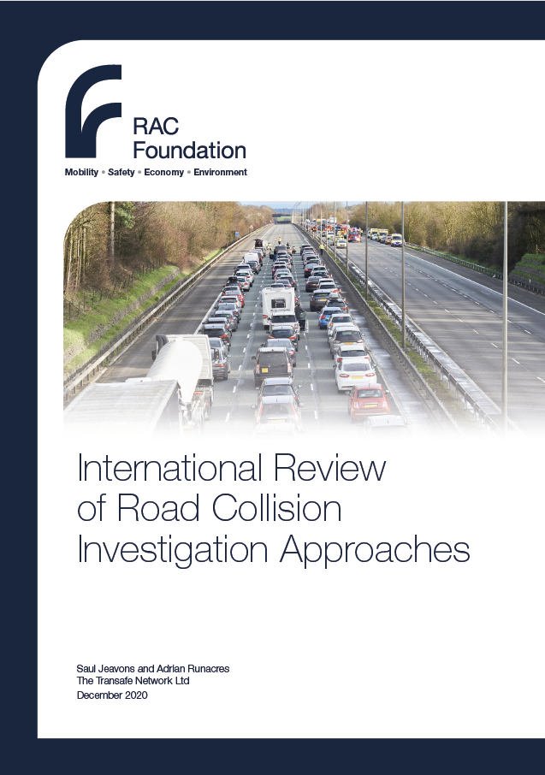

Road Safety Investigation Branch
“The branch will not identify blame or liability... It will instead draw on all the available evidence to make recommendations to improve road safety and mitigate or prevent similar incidents in the future.”

Slide 8
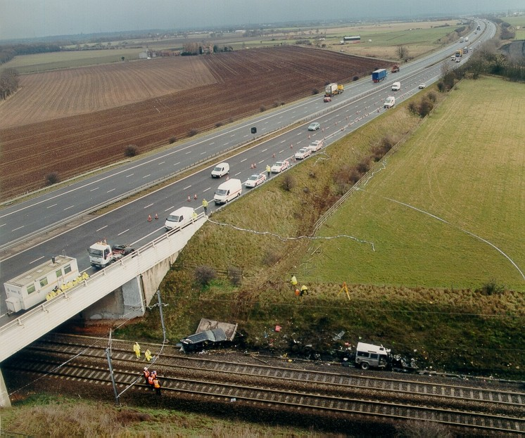

Slide 9
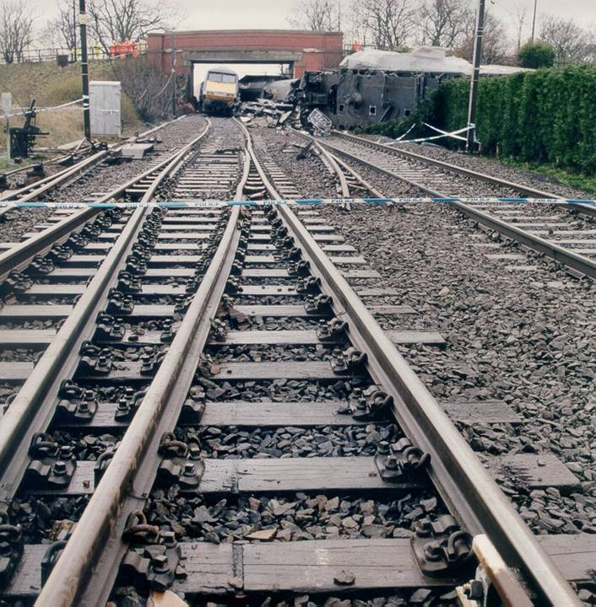

Slide 10
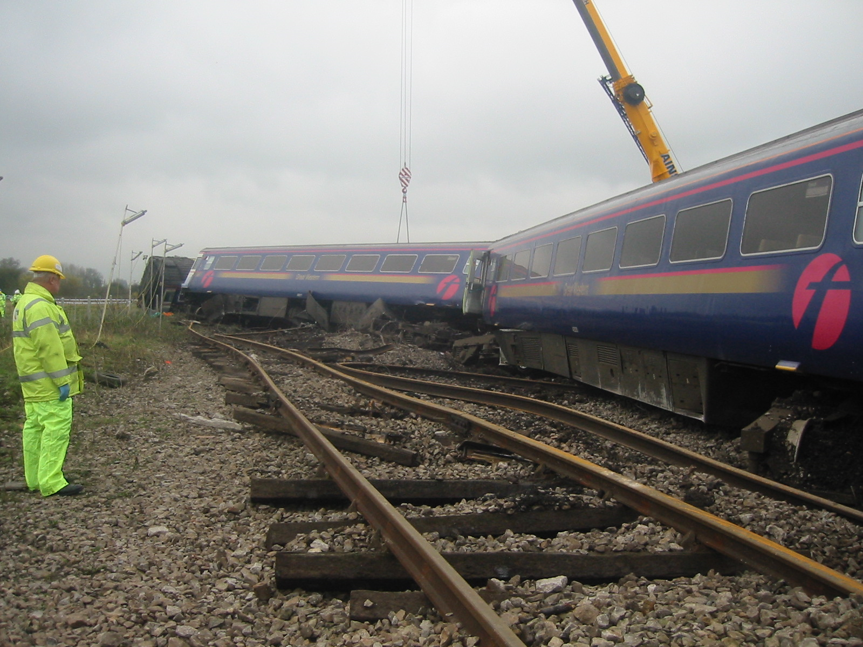
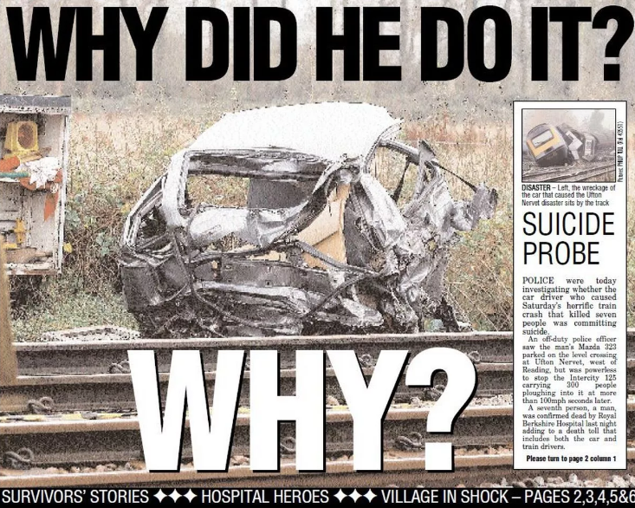

Slide 11
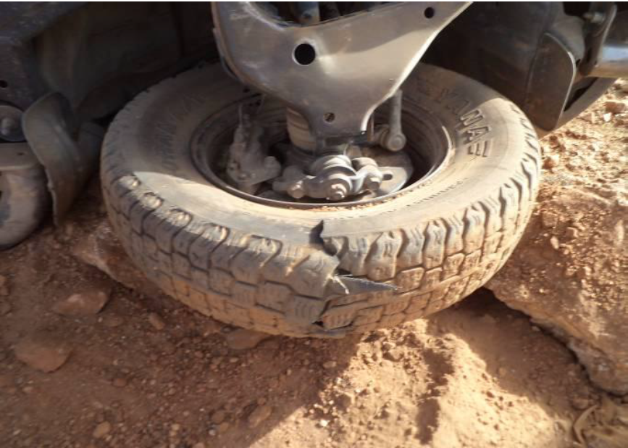
Single Incident Case Study

Slide 12

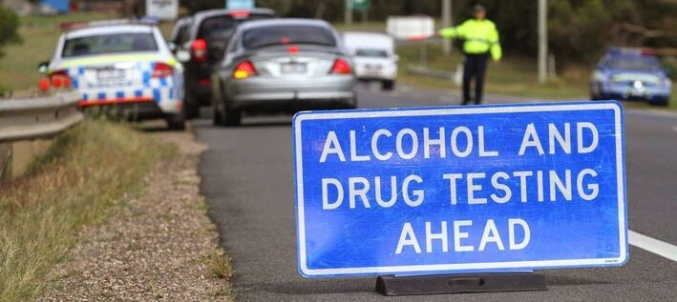
Single Incident Case Study

Slide 13

Tesco.com
Home Delivery Fleet
  Used by 51% of online grocery delivery users in the UK
  5,500 Vans
  Around 1 million deliveries a week
Collision Review Board
  Includes 2 x driver trainers, 2 x drivers and 1 x manager
  Primary consideration is what the company could have done to avoid the incident.

Slide 14
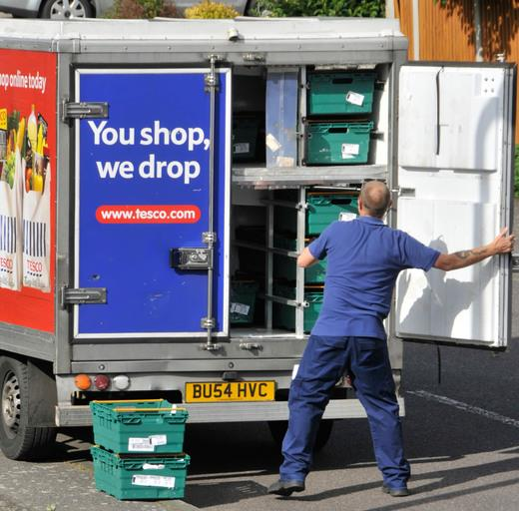
Single Incident Case Study

Slide 15

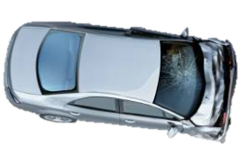
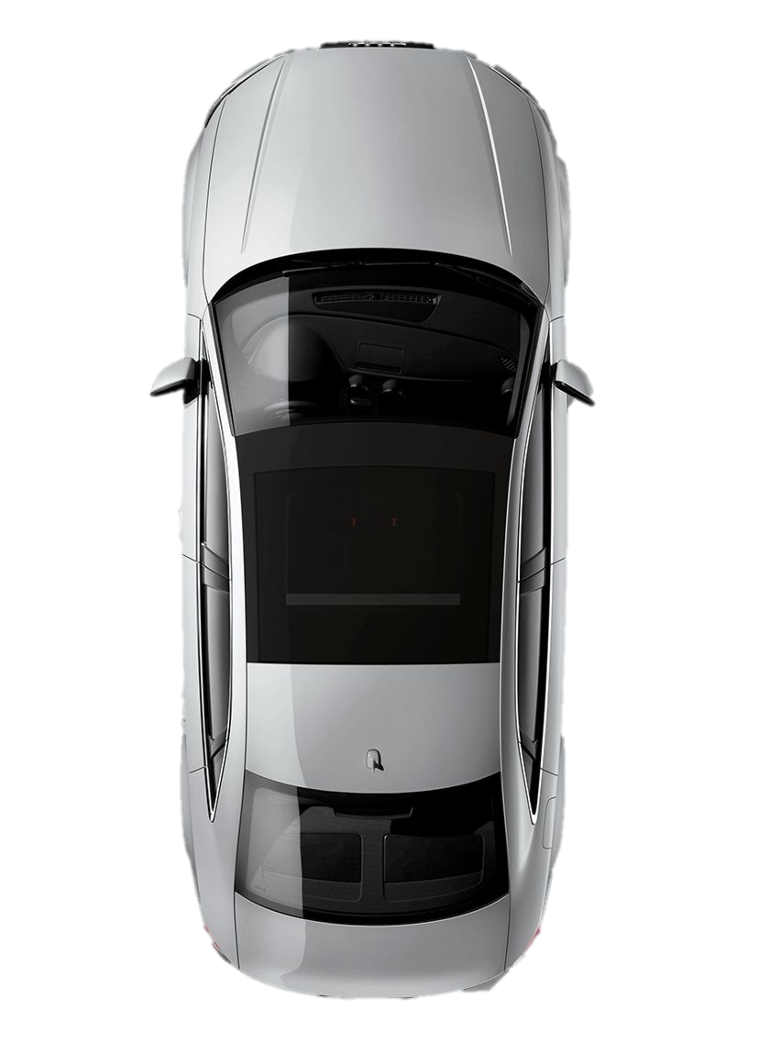

Slide 16
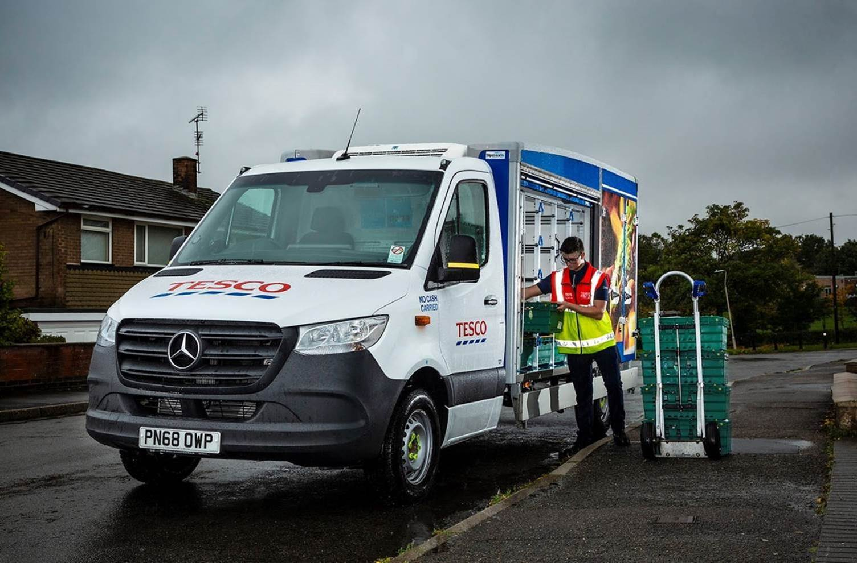

Slide 17
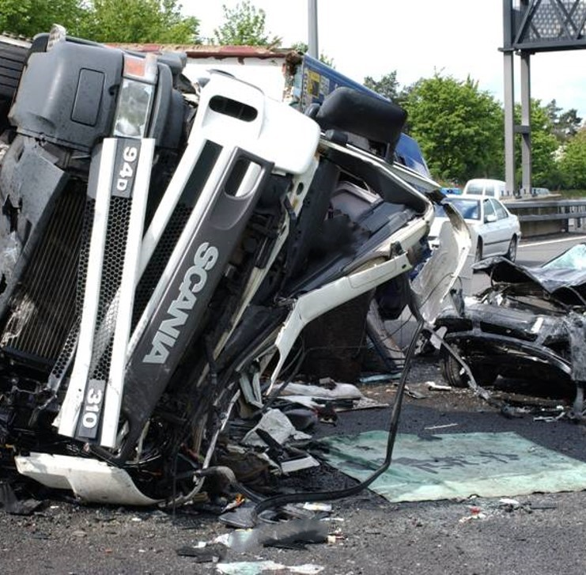
Join the Dots
Look at what might be an issue in future and not just what was an issue in this collision scenario
Think about causation of collision AND severity of injury

Slide 18
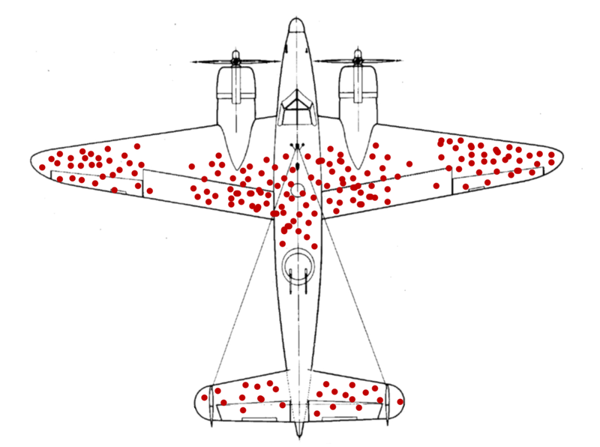
Survivorship Bias in reverse?

Slide 19
Work Pressures - Routing - Scheduling - Policies - Culture - Audit - Review -
The Organisation

Slide 20
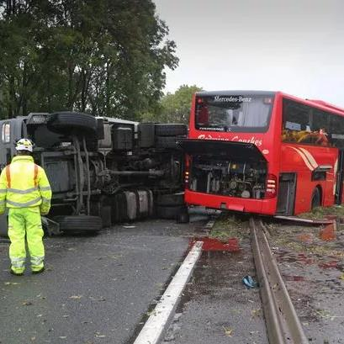
When do you hold your Review Board?
Part of the Investigation process… but at the end. Hold it too soon, you may not know the full story
Hold it too late, does the exercise become meaningless?
Legal Considerations:
“Wait until all Civil and Criminal proceedings have concluded.”?
Liability issues of waiting…

Slide 21
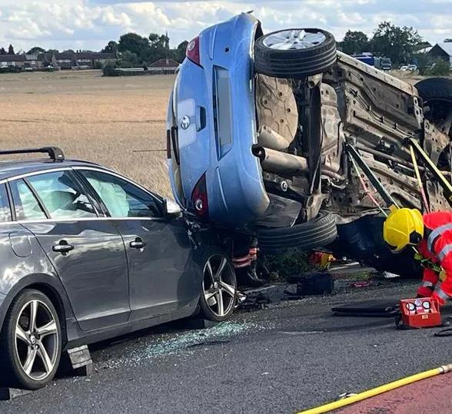

Safe System:
Priority or Value?
What do you do with the results?
“A commitment to safety
should not be a priority,
but a value that shapes decision making all the time, at every level.”
Rex Tillerson

Slide 22
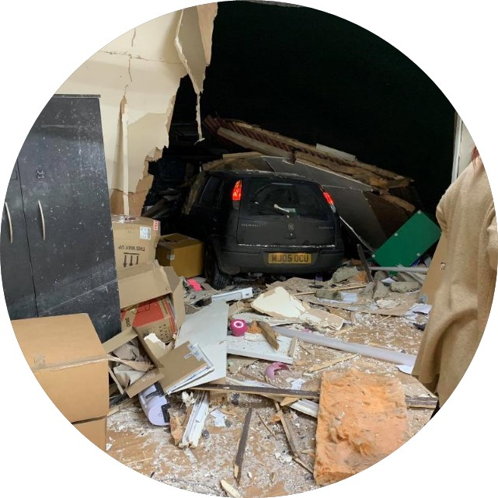
Key Takeaway Points
Don’t delay
Get the right people in the room – technical and seniority
System learnings – avoid
getting bogged down in incident specific discussions
Zero blame – focussing on system solutions is paramount

Slide 23
Thank You
saul.jeavons@transafenetwork.com
0207 112 7036
07789 395347

