Slide 1
Railway staff safety – breaking a tradition of 150 years
March 2024

Slide 2
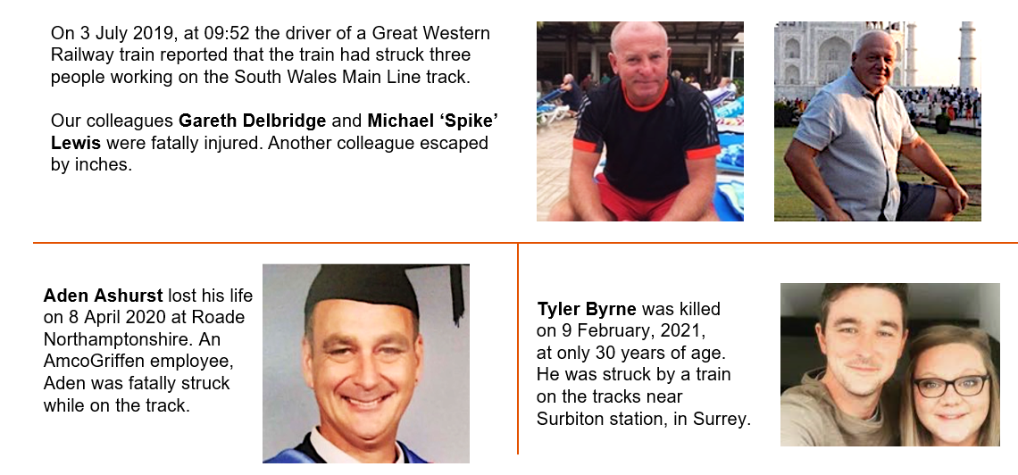
A reminder of some of our colleagues and why this is so important

Slide 3
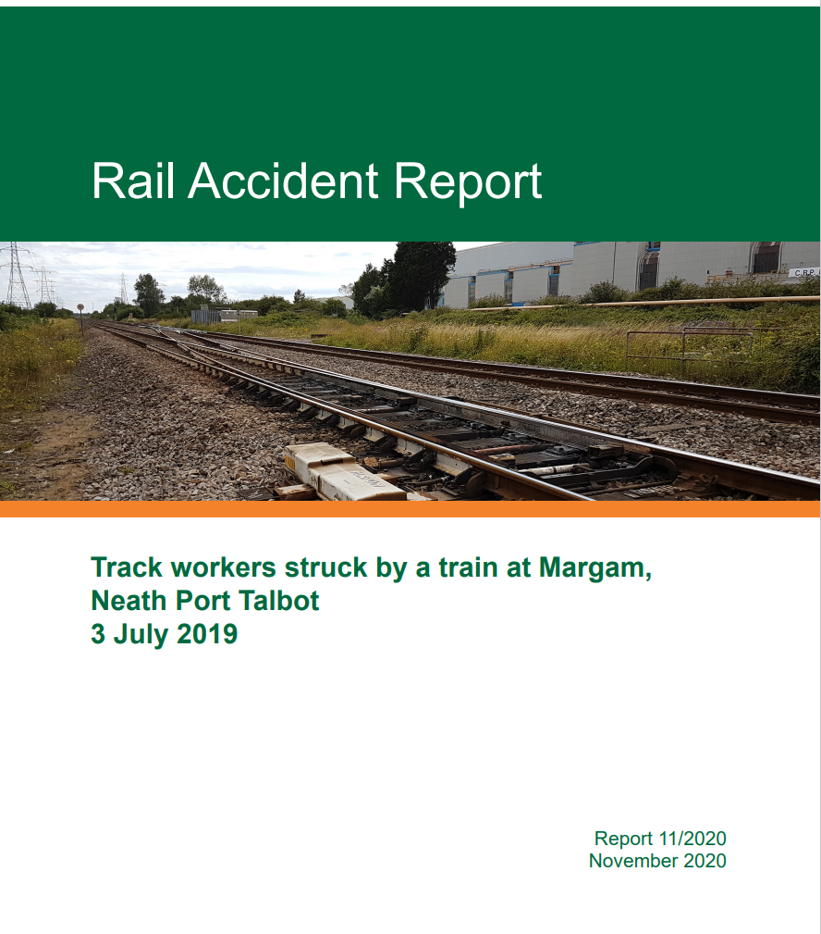
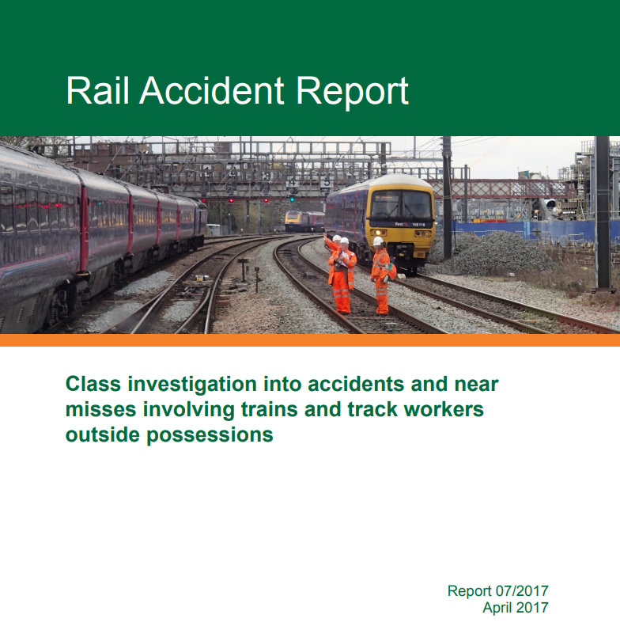
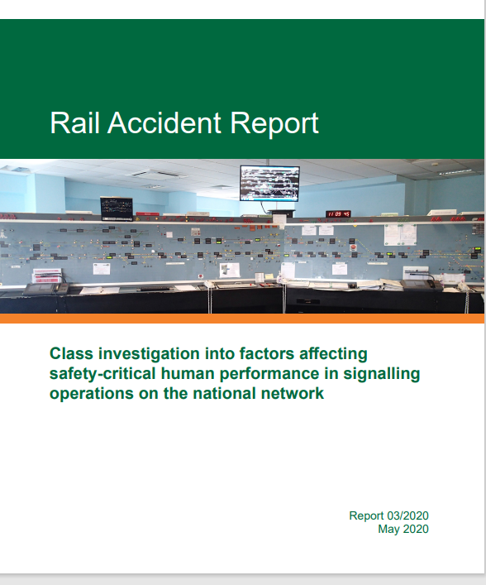
Multiple recommendations

Slide 4
We needed a Plan
Compliance Criteria
Achieved
1. Every delivery unit (DU) will have analysed ‘maintenance scheduled tasks (MSTs)’ and ‘routine work arising (WA)’ to align them with the available possessions and line blocks,;
2. Every route will have identified, analysed and allocated the available windows for undertaking maintenance work in possessions and line blocks for current and future timetables, for all lines;
3. Every route will maintain live register for each route-section that depicts, for routine maintenance tasks:
a. Green – Suitable access and resources are available;
b. Amber – Suitable access or resource has been applied for and assumed to be forthcoming to safely maintain the railway;
c. Red – Insufficient access or resource is available necessitating other protection or warning arrangements.
4. Every route will be able to demonstrate that the required level of available safe access has been secured via the engineering access statement (EAS) process for the December 2021 timetable,
5. Every route will be able to demonstrate management oversight and assurance
to show maintenance tasks are planned into and delivered in the available possessions and line blocks.
MSTs
From Sept 2019 to April 2022 - reviewed and replanned
4.1m annual work orders into safest possible method
EAS Process
Maintenance in possessions up from 27% to 44%
Line Block Planning
Maintenance in line blocks up from 35% to 53%
Extra bids through EAS – some success but drew back from Network change when ORR did not support
NR RailHub
NR RailHub solution, live in 7 routes (rest by November)
Integrated planning, robust process, better data
Every route has a RAG access register
Boots off Ballast
PLPR live coverage up from 62% to 89% - 1.2m work orders safer.
Eddy Current live coverage up from 67% to 77% - 1.2m work orders safer.
Drone trials to undertake survey and inspection work
Site of work protection to protect work groups when additional protection is not available.
Understand signaller workload
500 miles of safe access to assets - 4298 walkways in Ellipse.

Slide 5
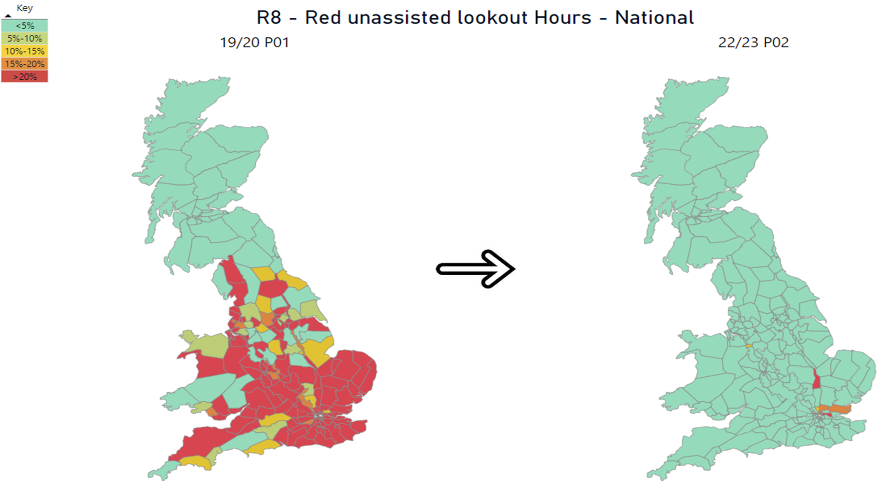
Planning Programme Outcomes
Unassisted Lookout Working Reduction – 98%

Slide 6
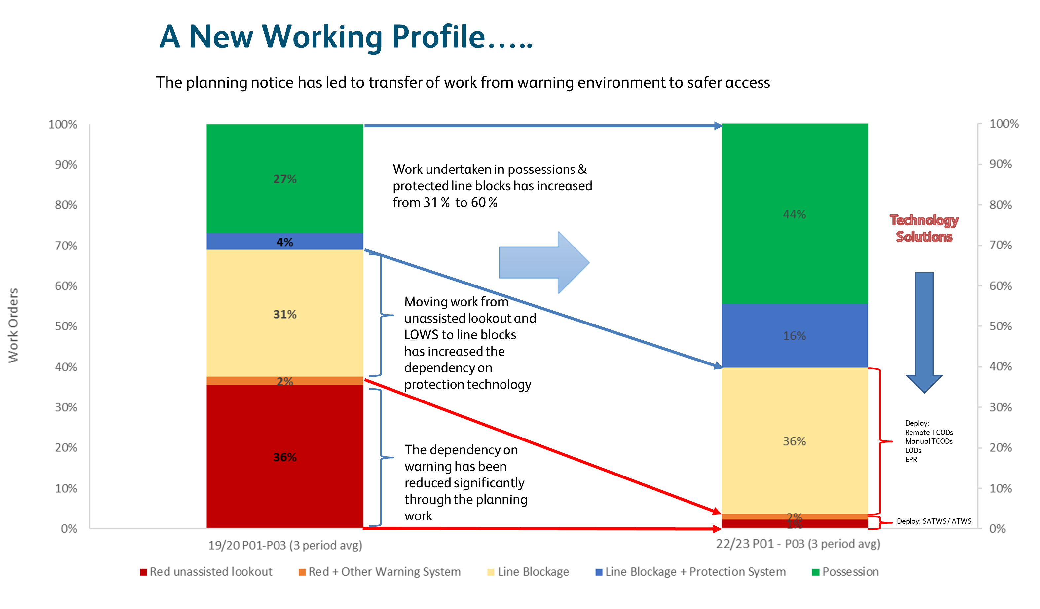
A New Working Profile…..

Slide 7
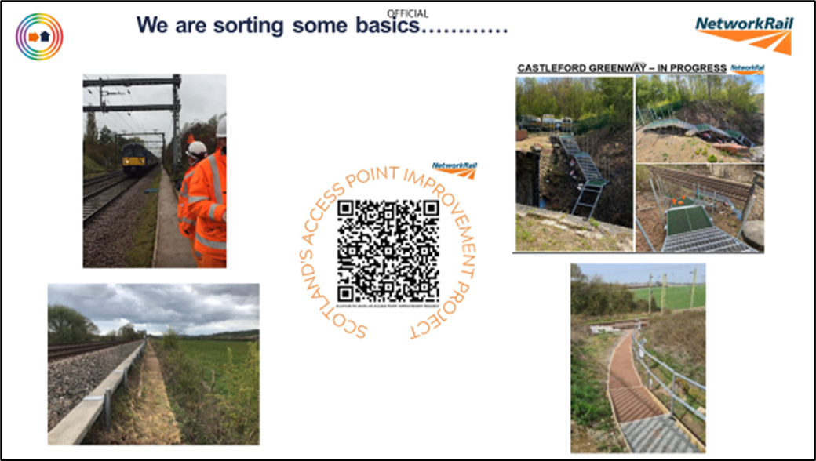

Slide 8
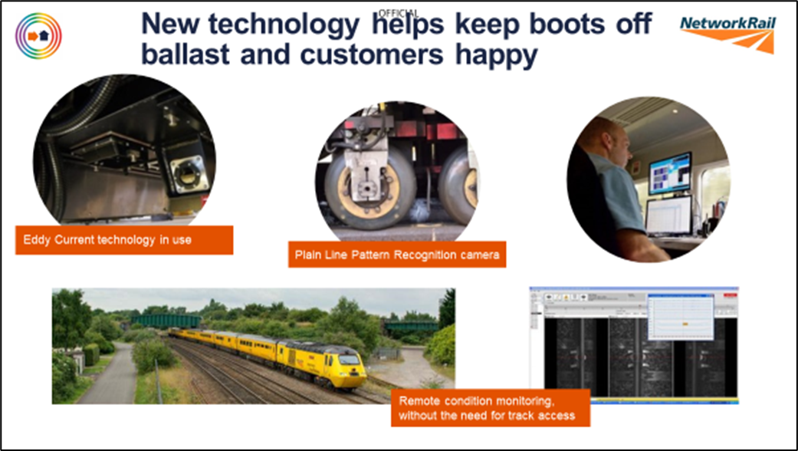

Slide 9

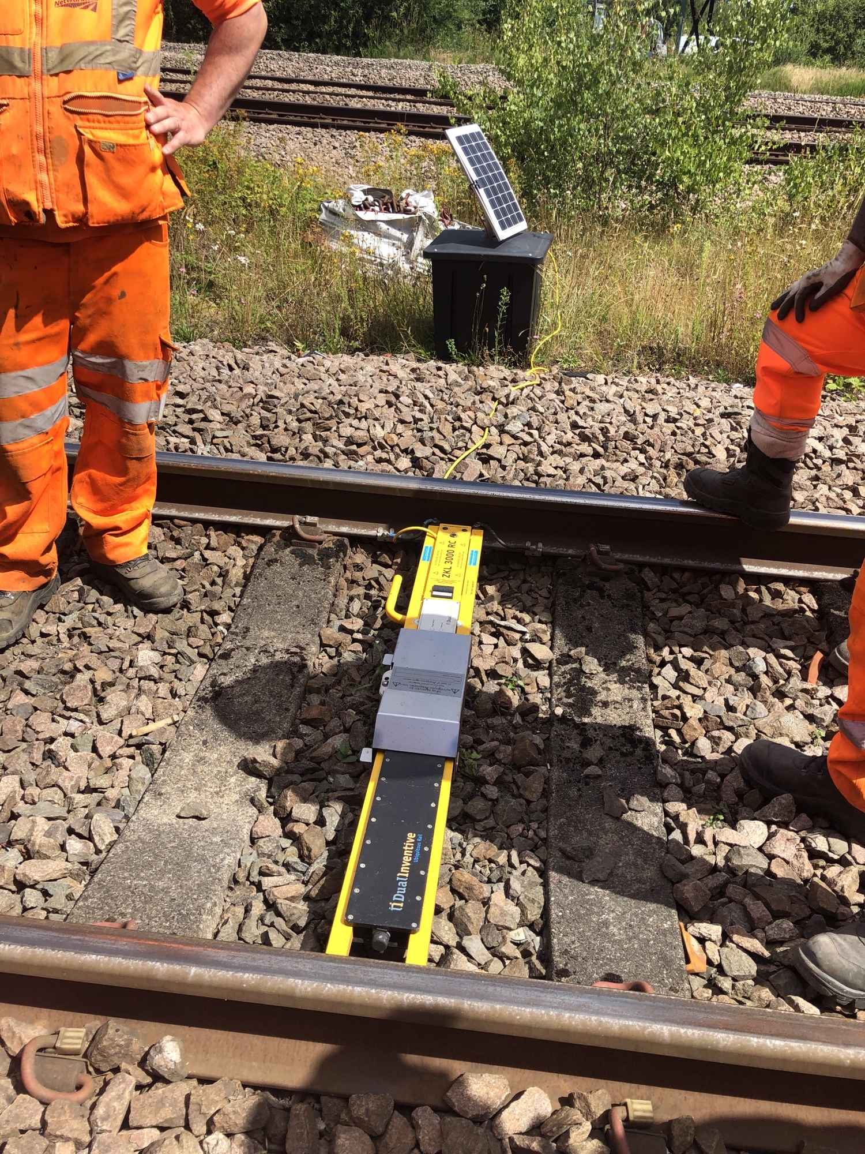
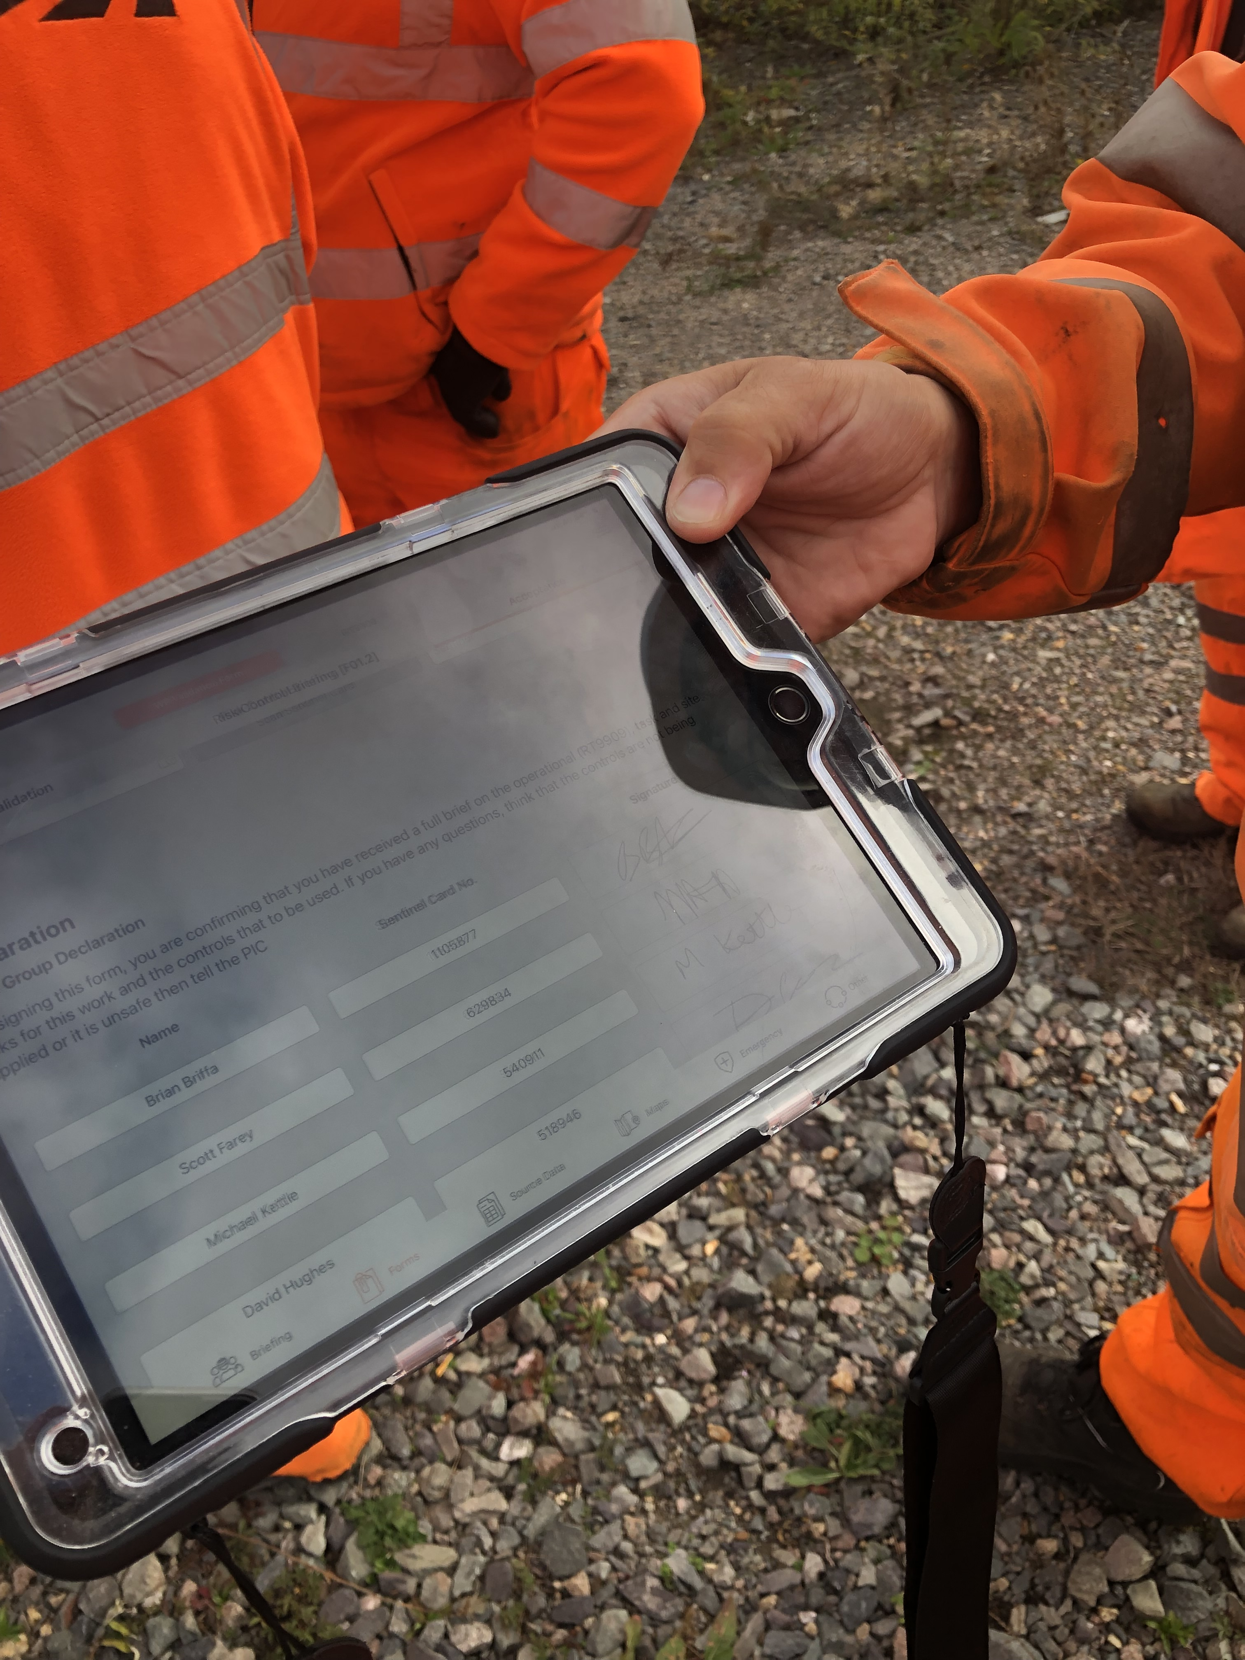
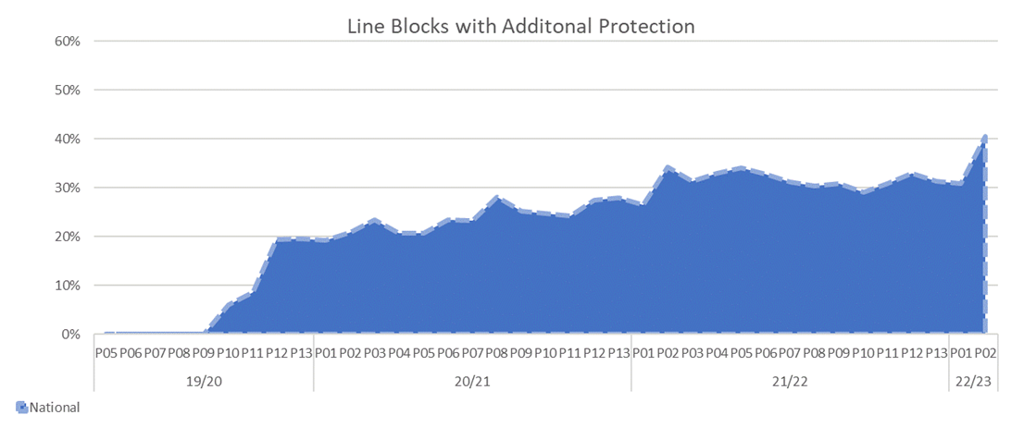
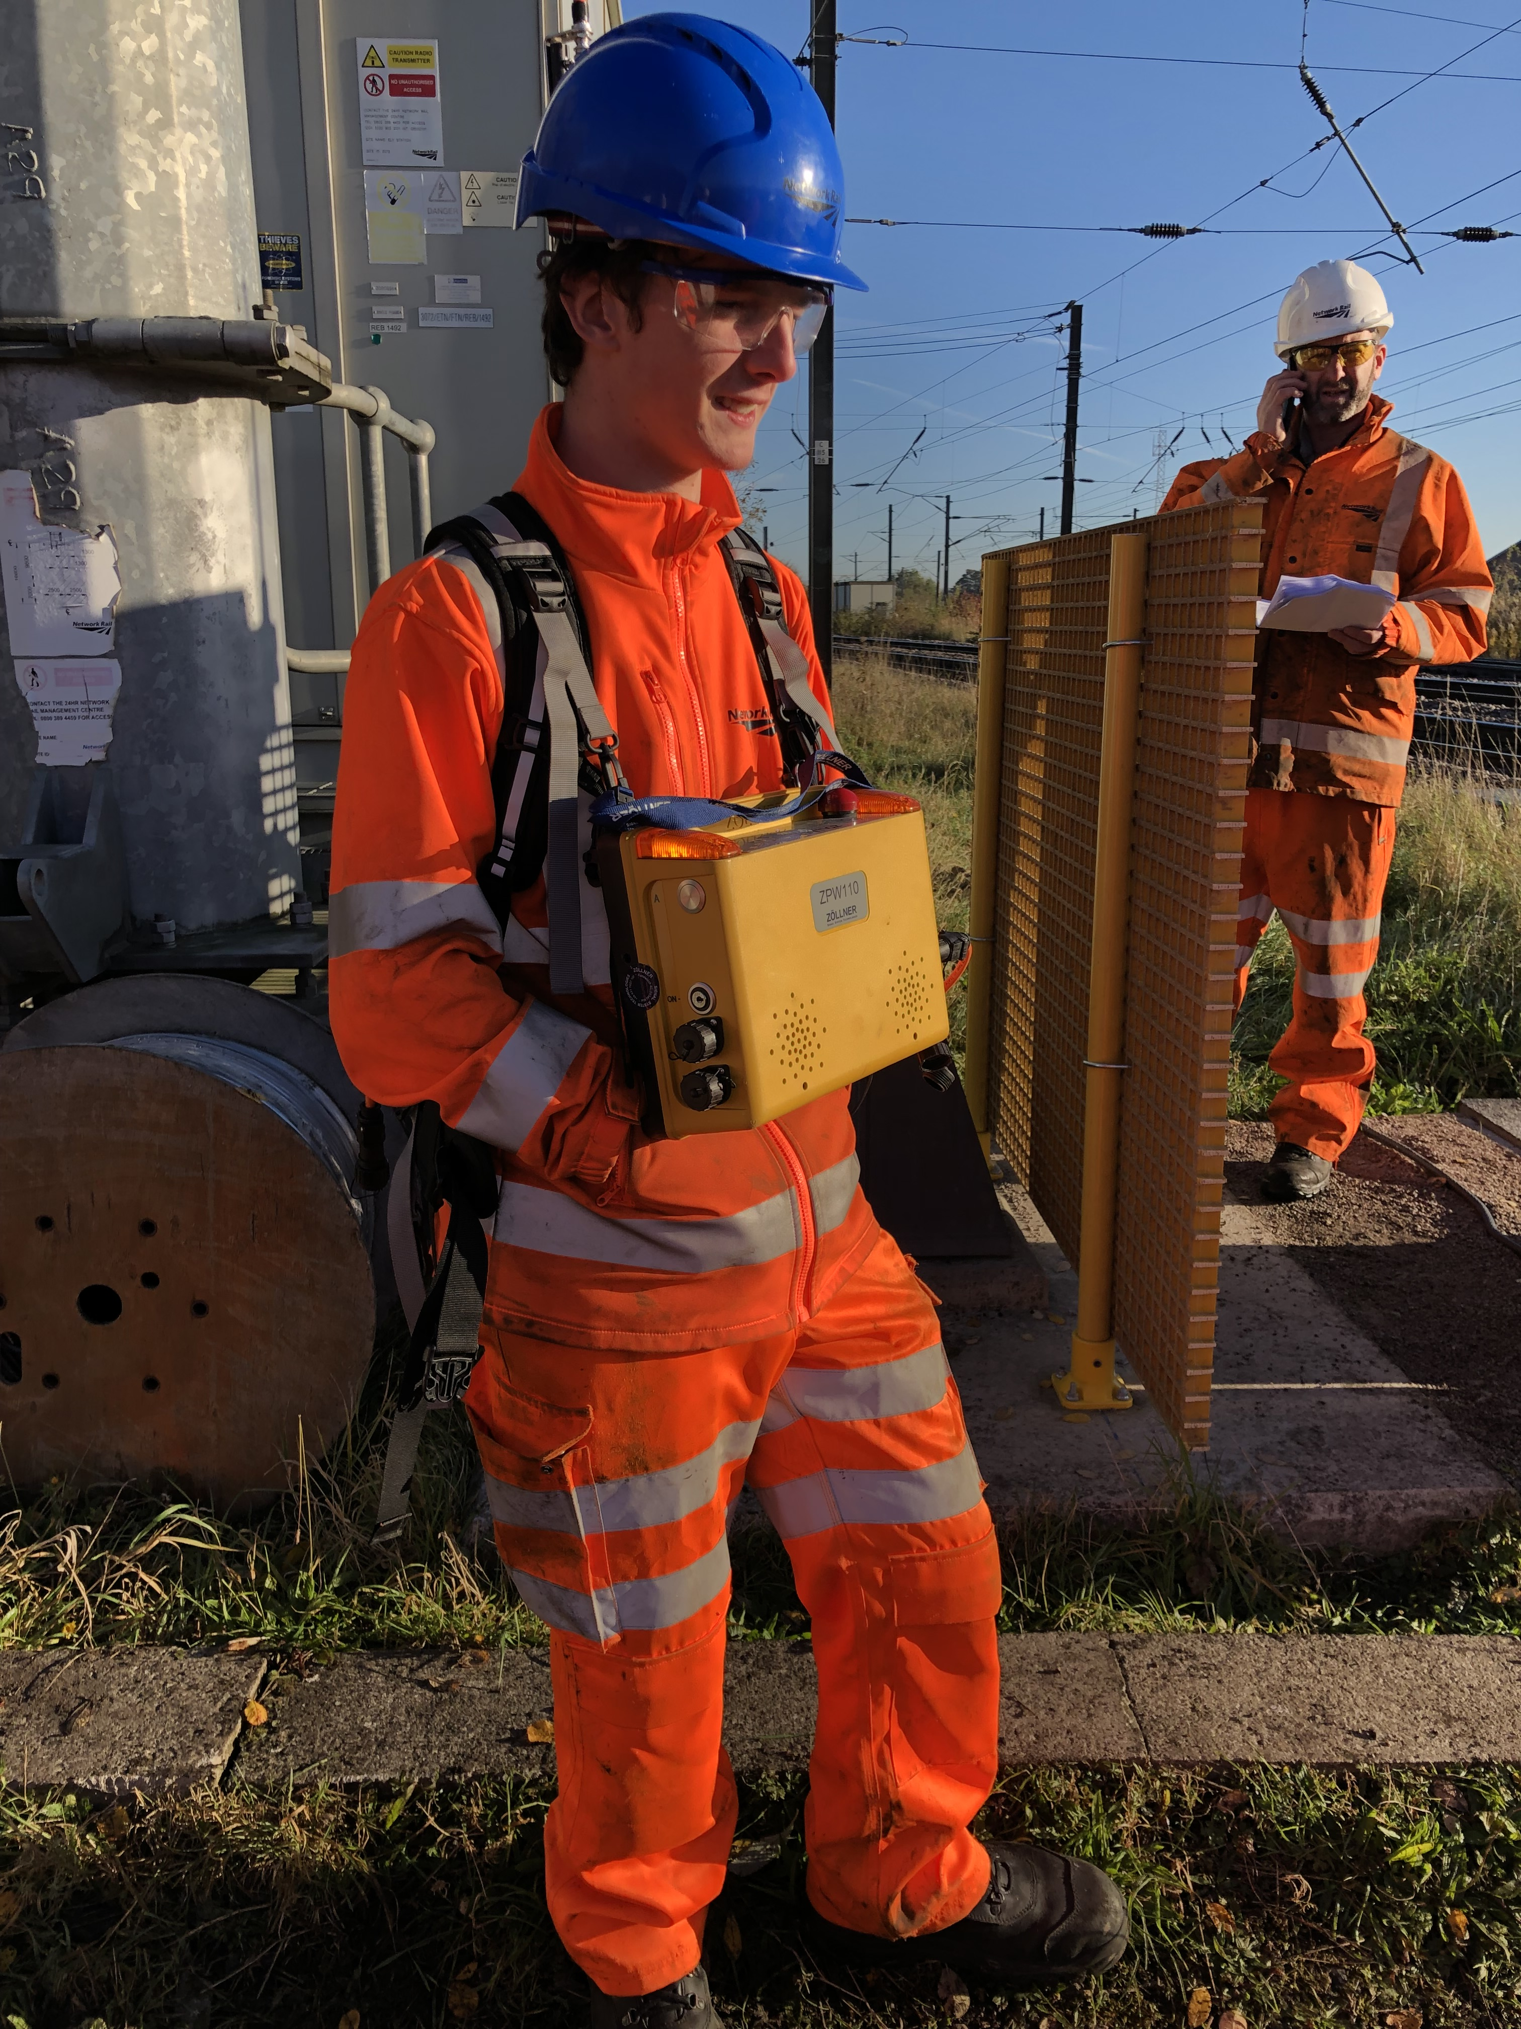
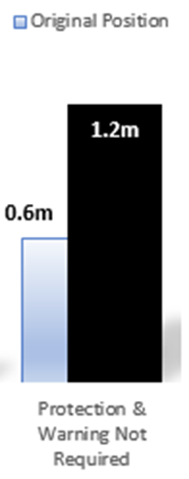
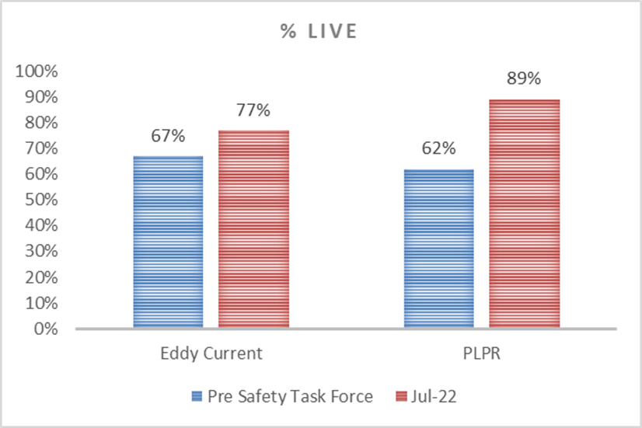
Technology Programme Outcomes
PLPR Increase from 62% coverage to 89%
Eddy Current Increase from 67% coverage to 77%

Slide 10
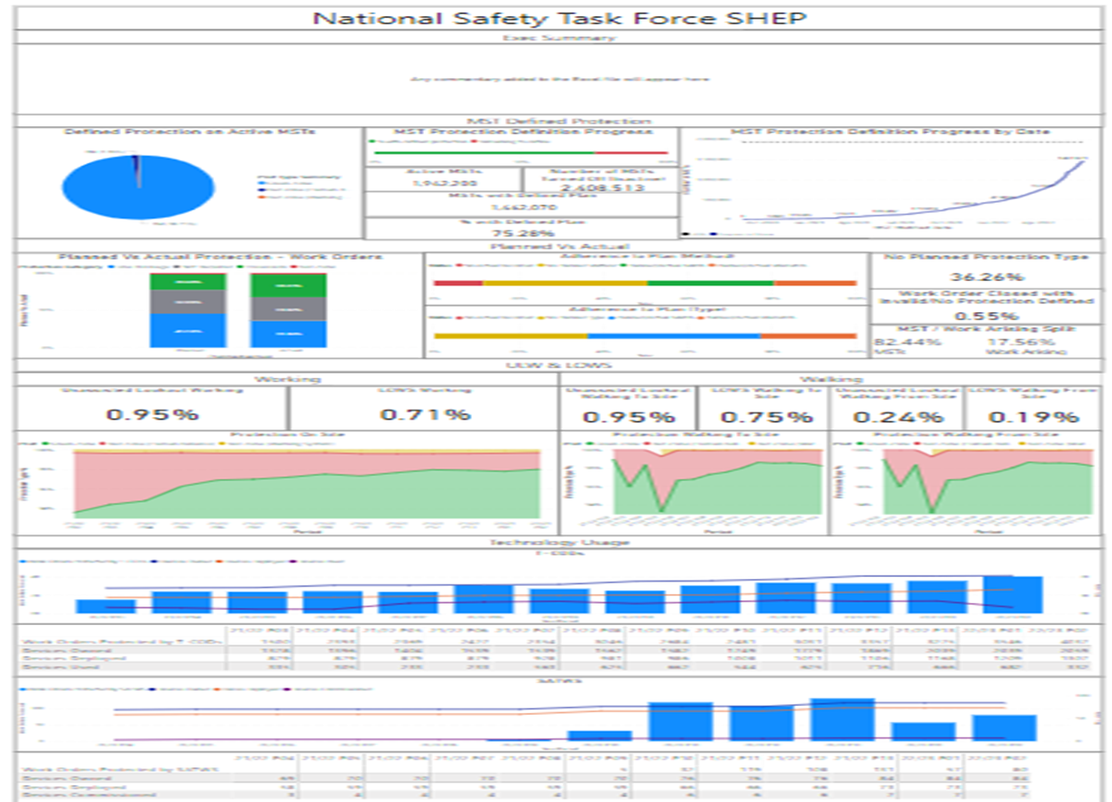
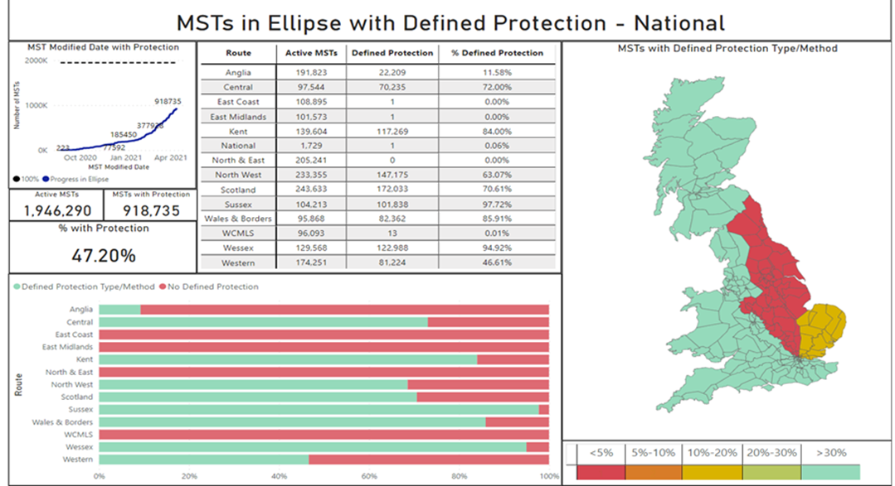
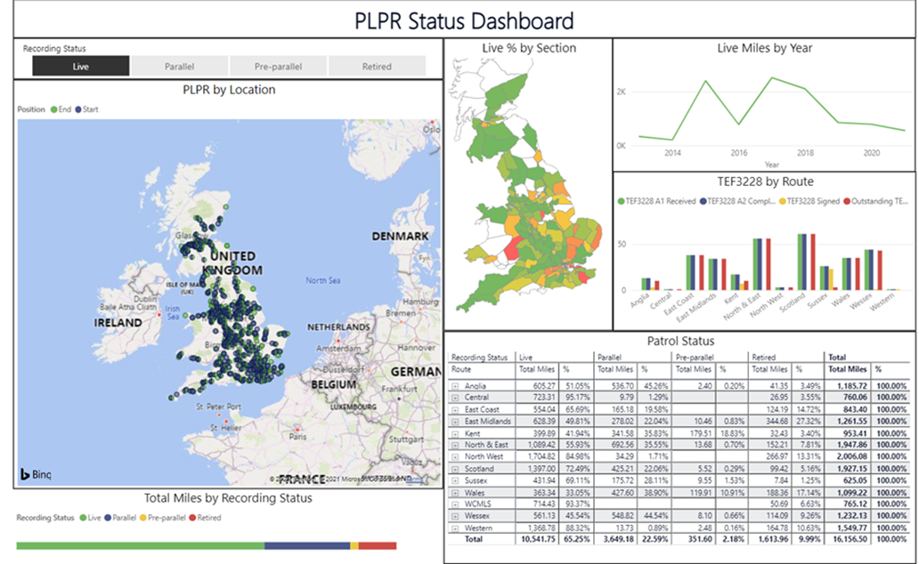
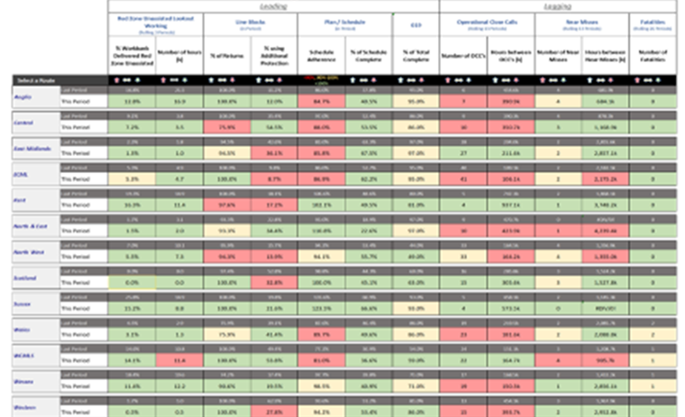
Oversight - Reporting
Leadership - SHEP
Management – Periodic Reporting

Slide 11
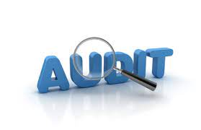


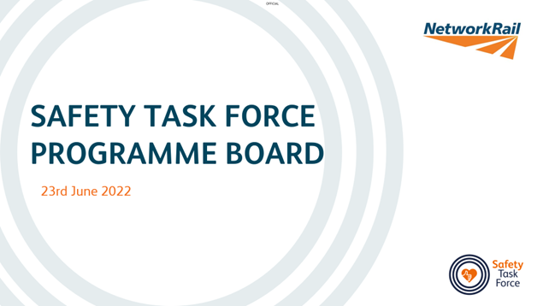
Oversight - Assurance
Track Worker Safety Audits
Leadership – Track Worker Safety Expert Group
The ‘Track Worker Safety Expert Group’ (TWSEG) was formed in response to RAIB Margam recommendation five, to ensure that Network Rail’s future work improving track worker safety is overseen and guided by an independent senior expert group over many years.
Post Implementation Reviews
Leadership – STF Programme Board
The STF ‘Programme Board’ will continued until at least June 2323. The board provided oversight and monitoring of route compliance with the sentiment of the two ‘Improvement Notices’ relating to track worker safety

Slide 12
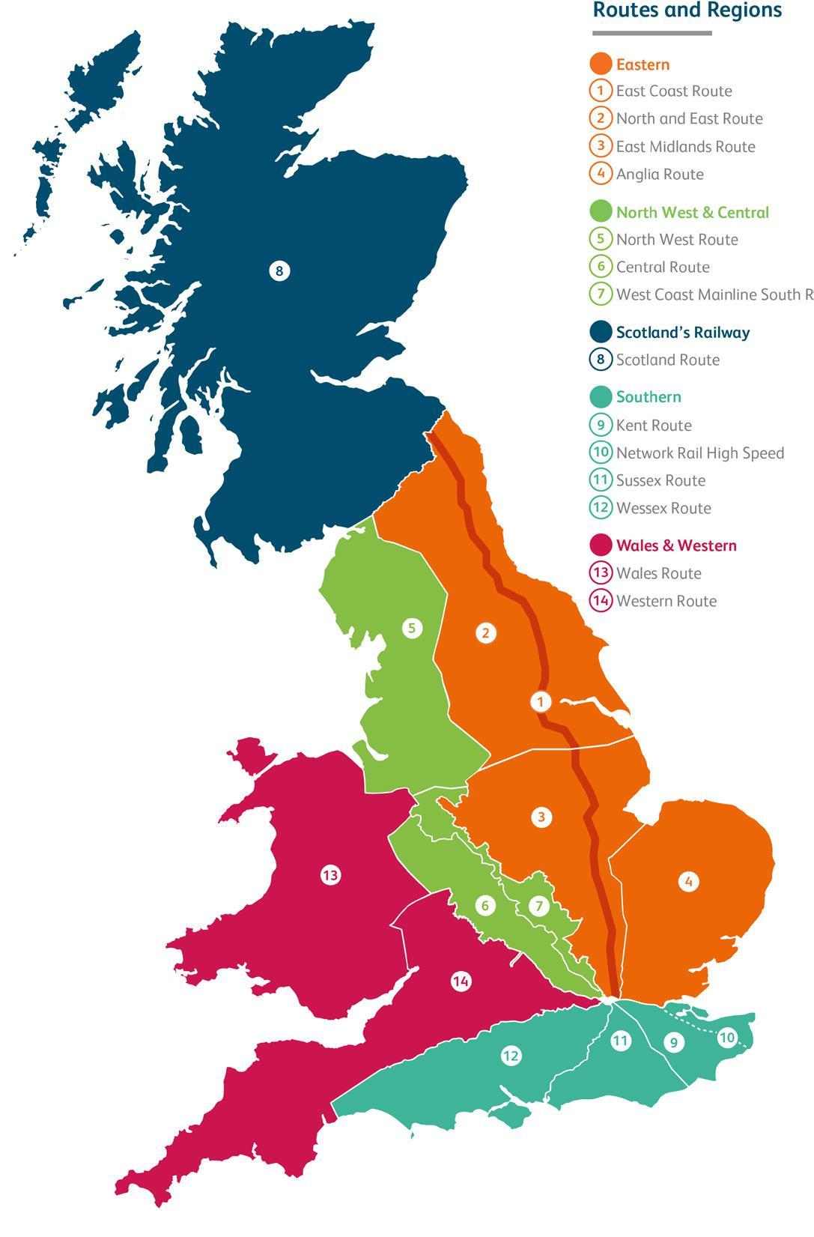
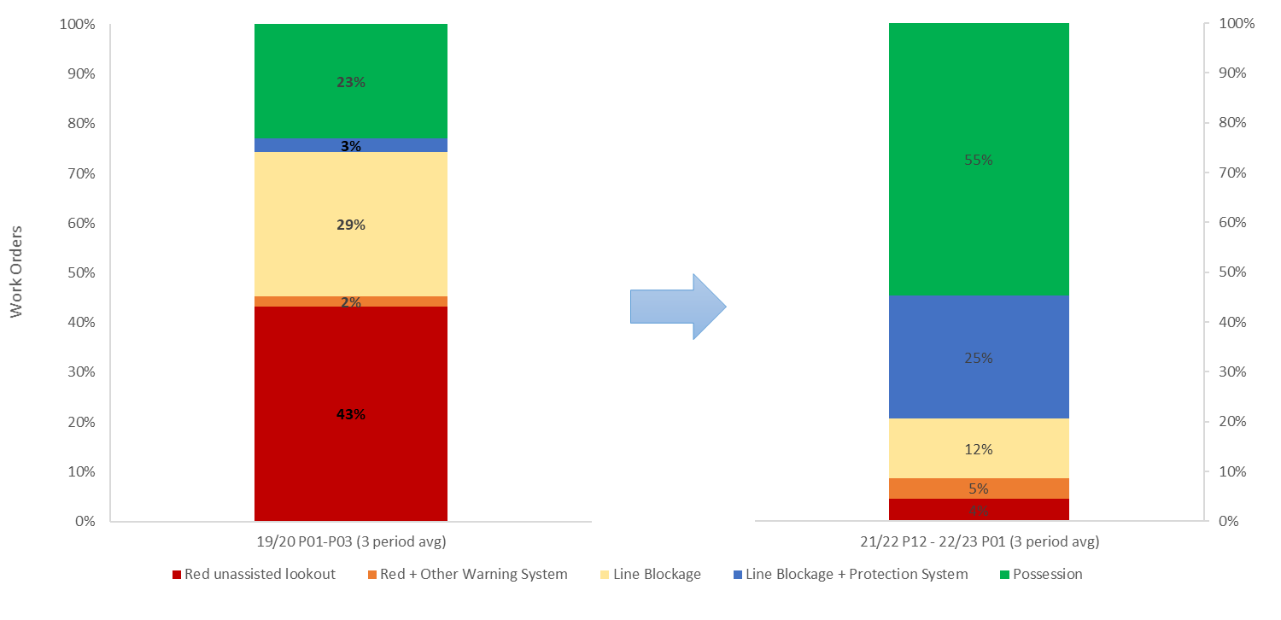
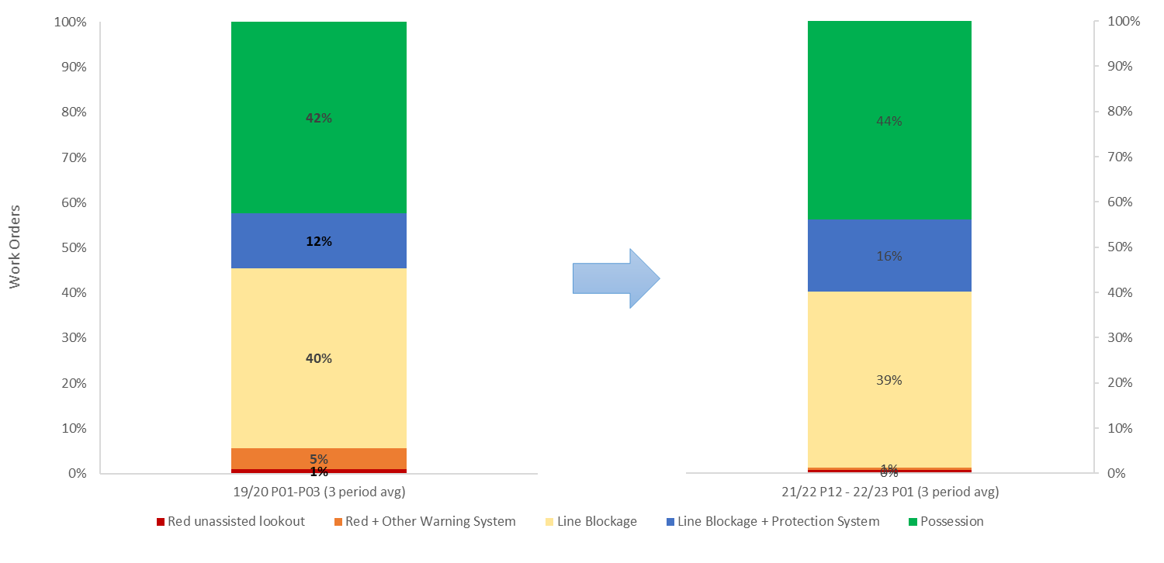
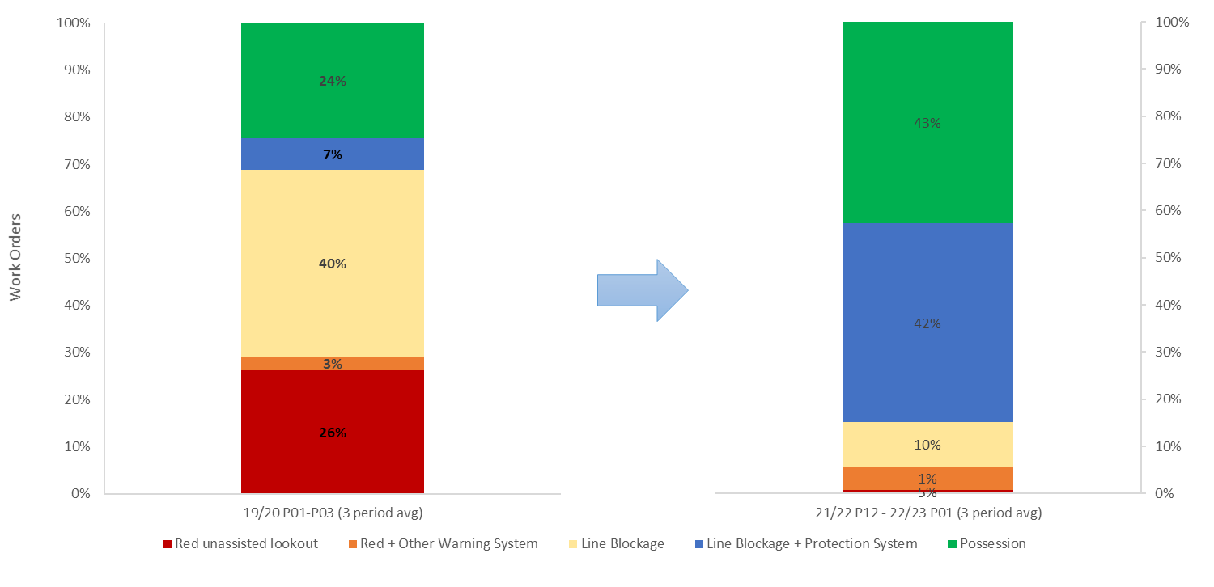
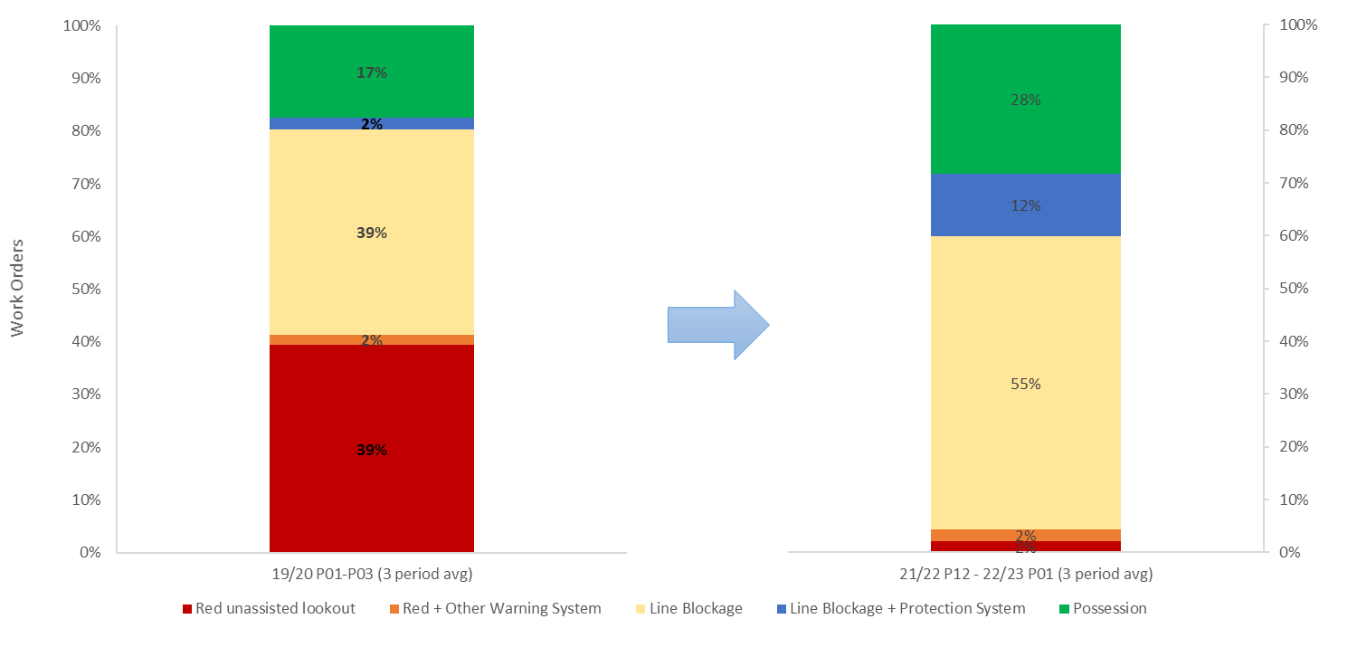
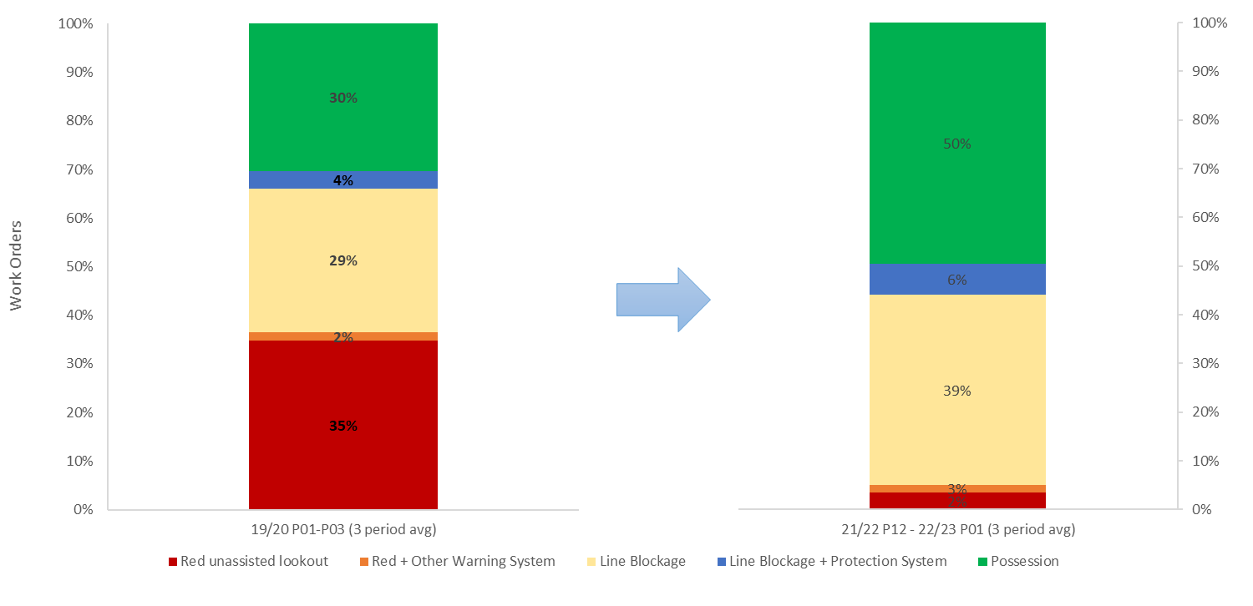
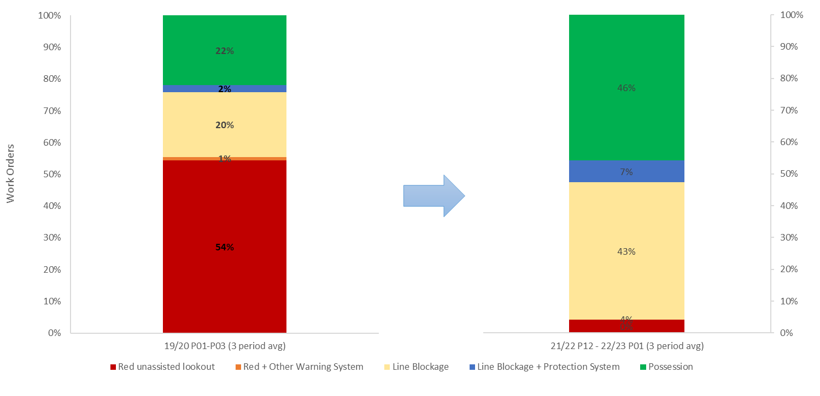
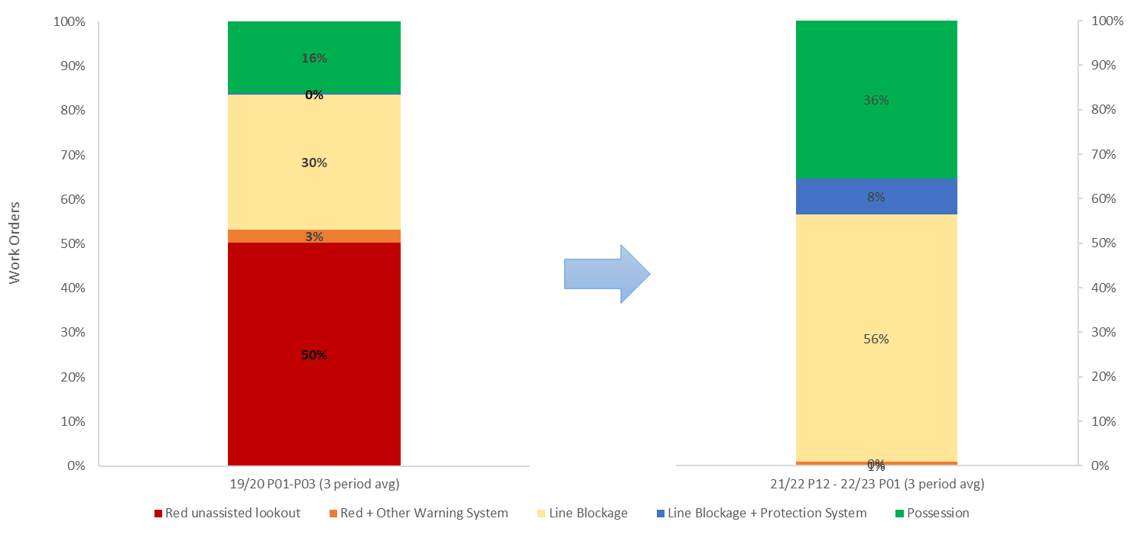
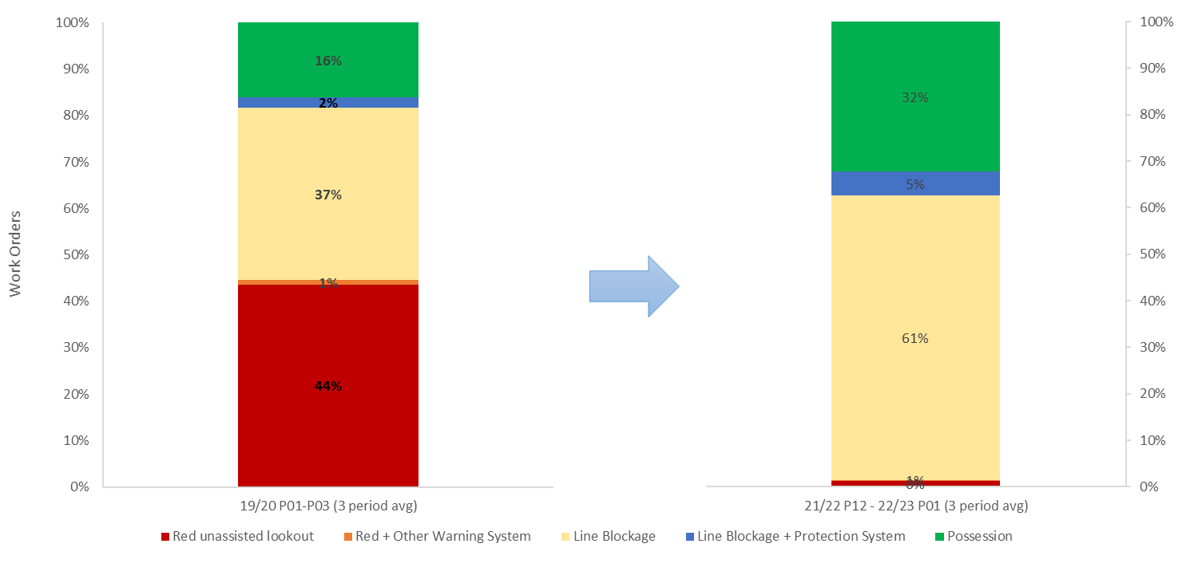
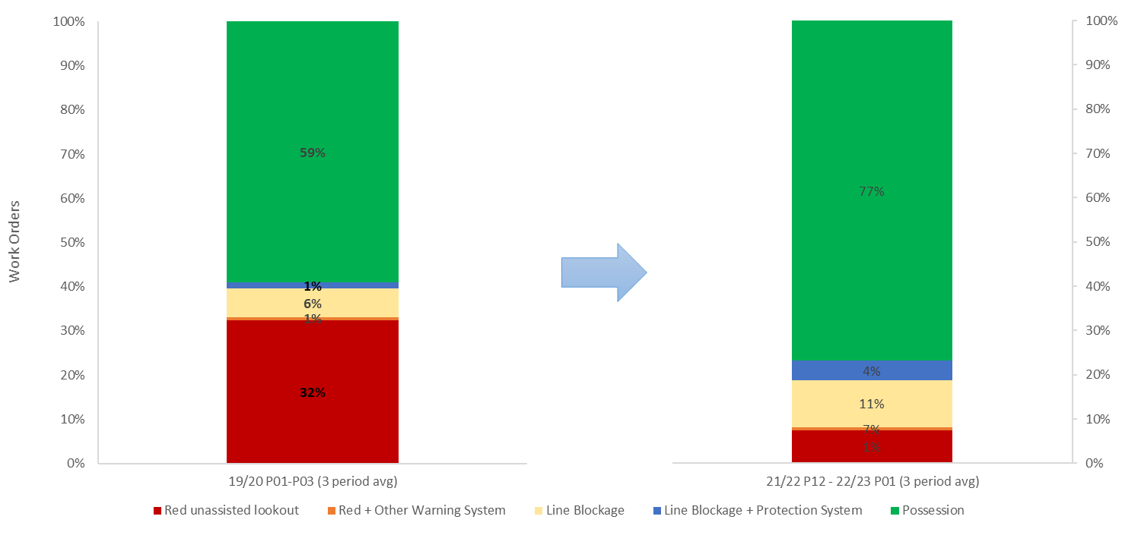
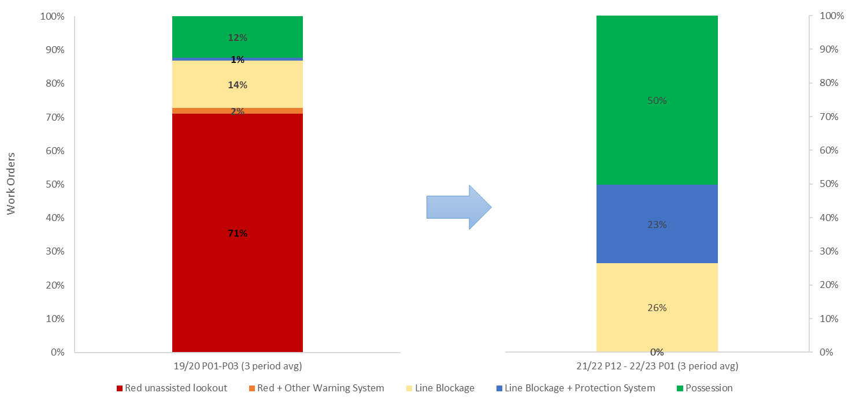
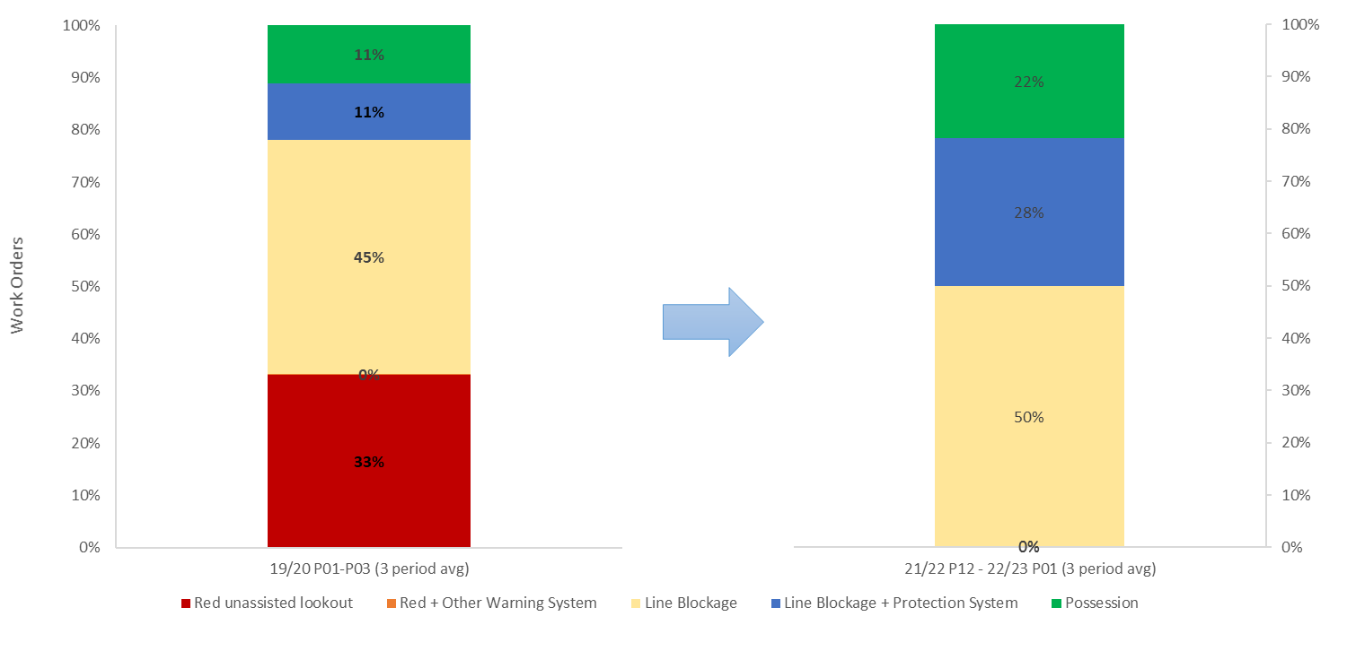
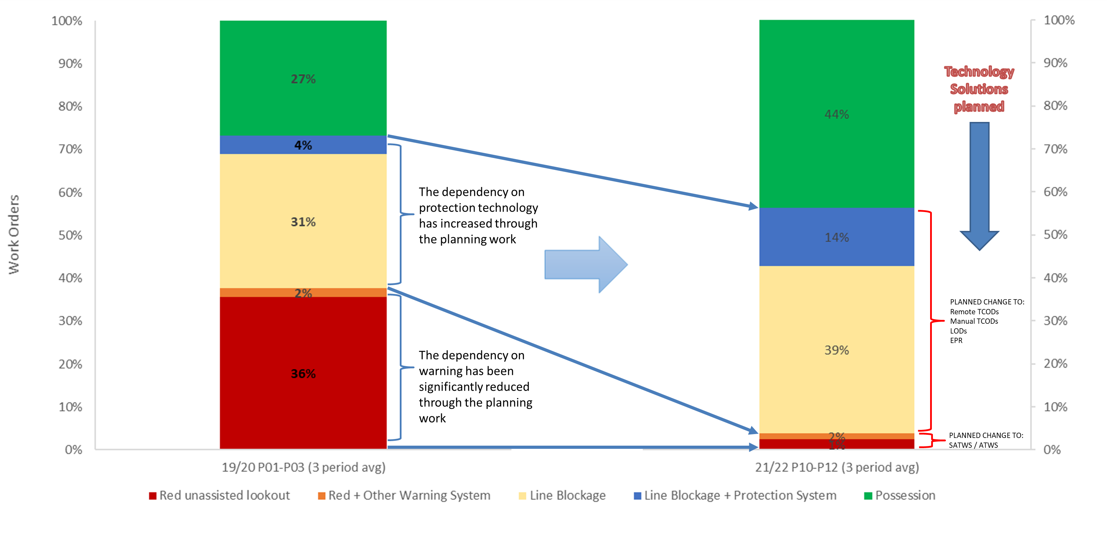
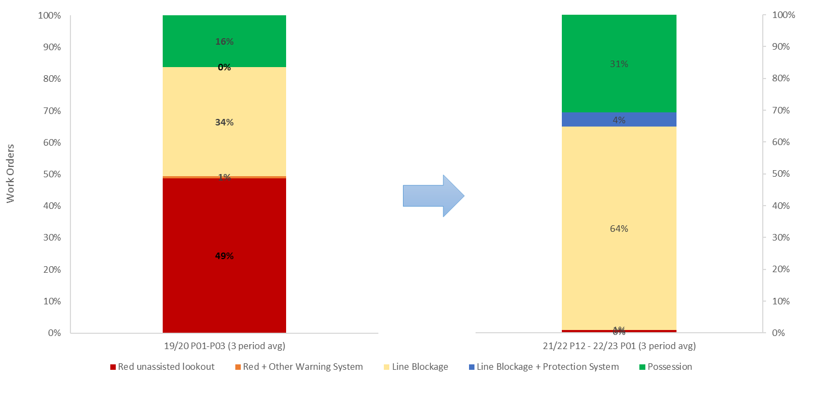
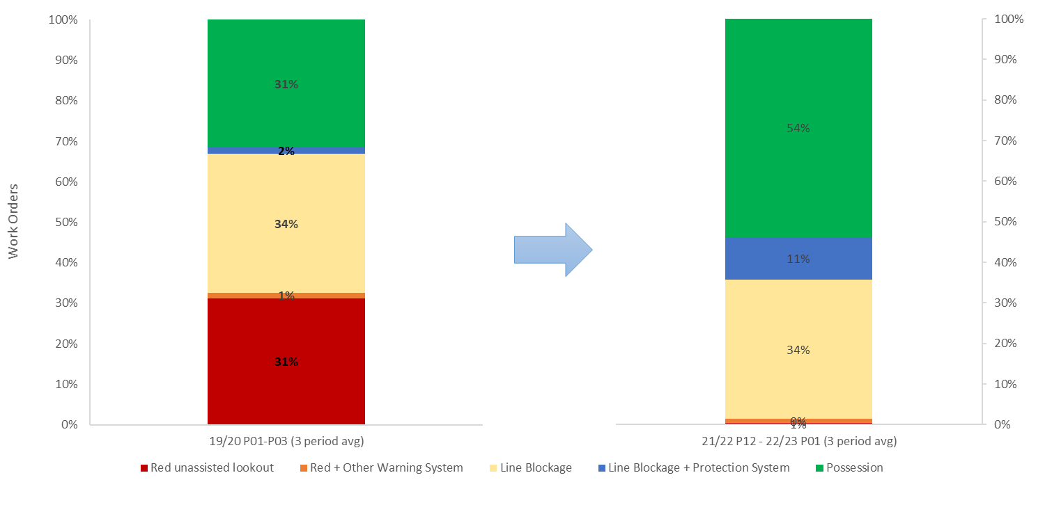
Increase Line Block Working – Focus on Line Block Safety
1- East Coast from 32% to 37%
8 – Scotland from 52% to 55%
2- North & East from
47% to 52%
3- East Midlands from 41% to 67%
5 – North West from 33% to 45%
4 – Anglia from 22% to 50%
6 – Central from 30% to 64%
12 – Wessex from 39% to 66%
7 – West Coast South from 7% to 15%
11 – Sussex from 15% to 49%
13 – Wales from 56% to 78%
National from 35% to 53%
9 – Kent from 34% to 68%
14 – Western from 36% to 45%

Slide 13
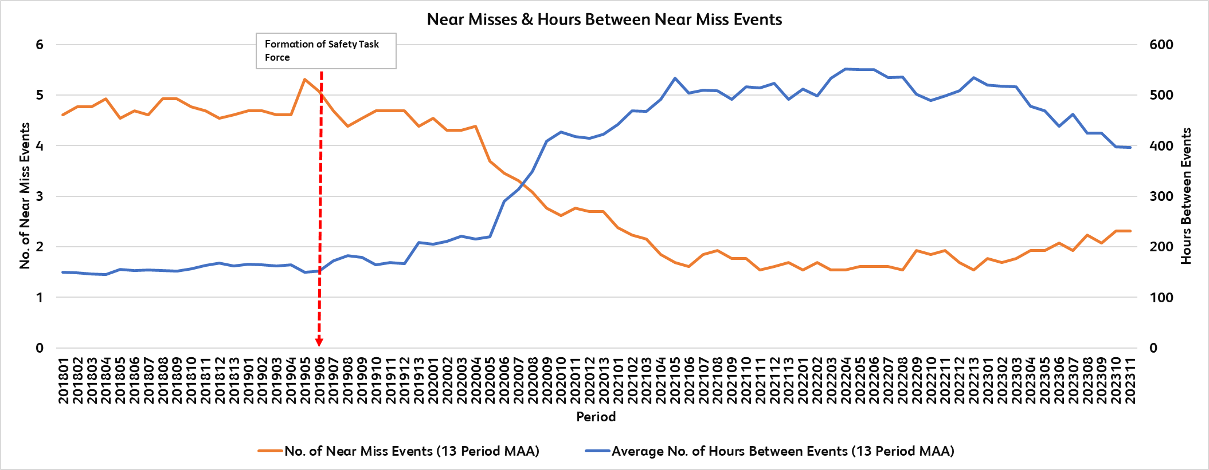
Near Miss Analysis

Slide 14
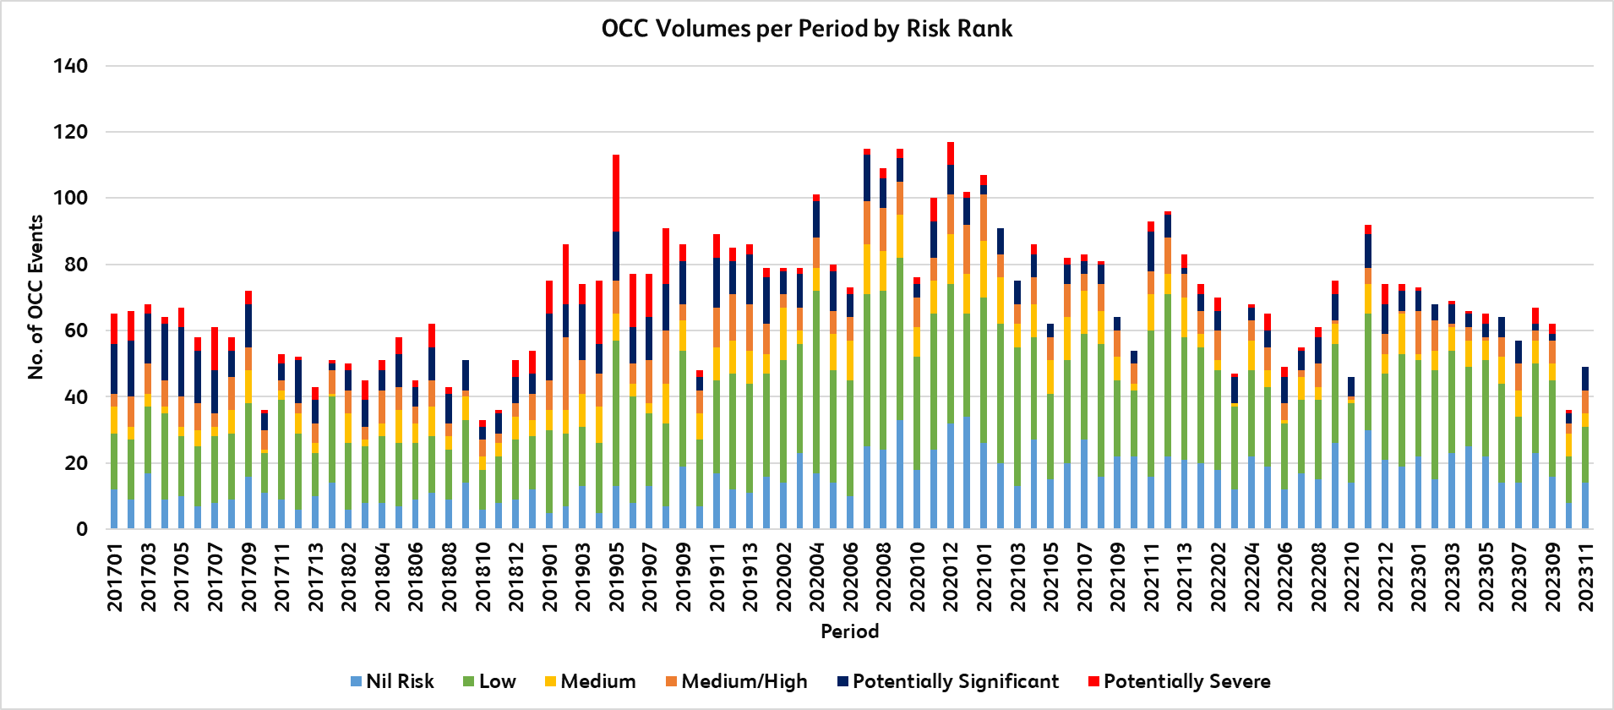
Operational Close call analysis

Slide 15
Lessons learnt
Focus on an outcome
Have a plan
Keep focus on the plan
Deliver the plan
Keep focus on the plan

