Slide 1

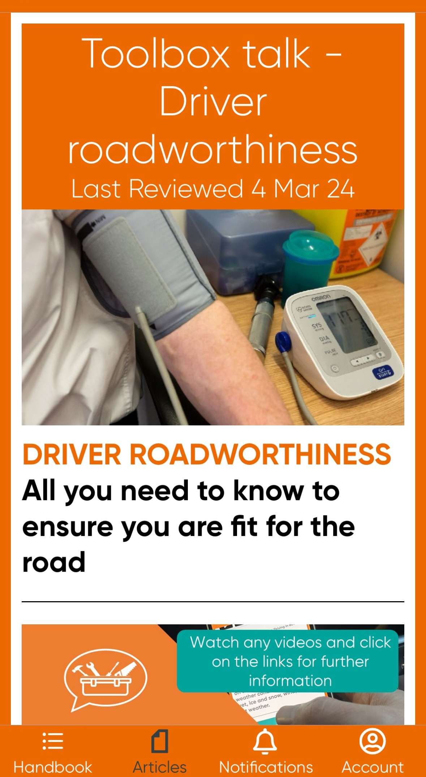

Driver Roadworthiness
What’s under the bonnet?
Glen Davies -The Driver Handbook

Slide 2
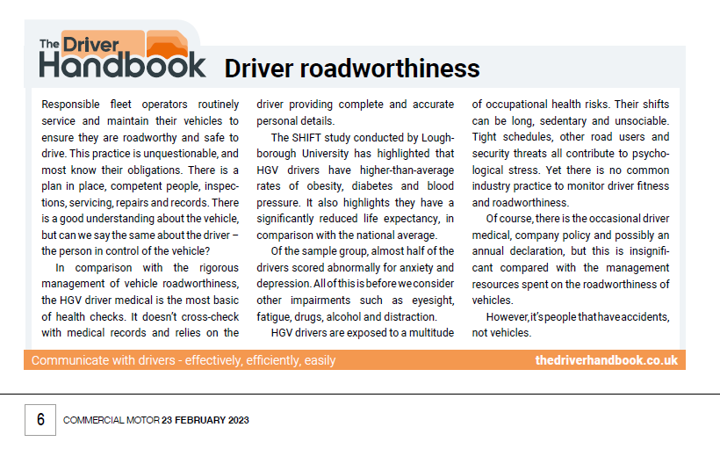

Slide 3

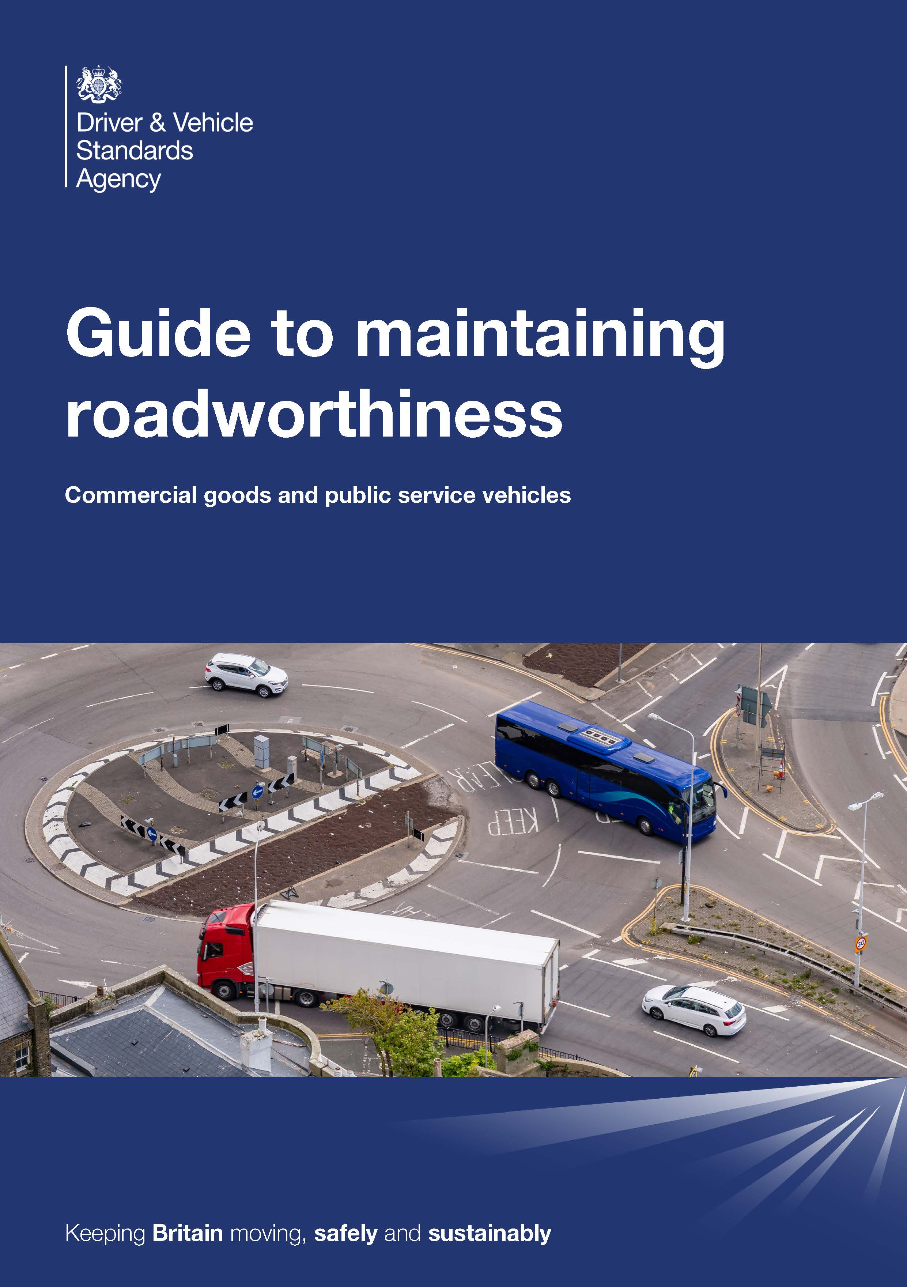





Guide to maintaining roadworthiness
of road traffic collisions are caused by human error
95%
Human error
95%
Vehicle failure
Environmental factor
5%

Slide 4
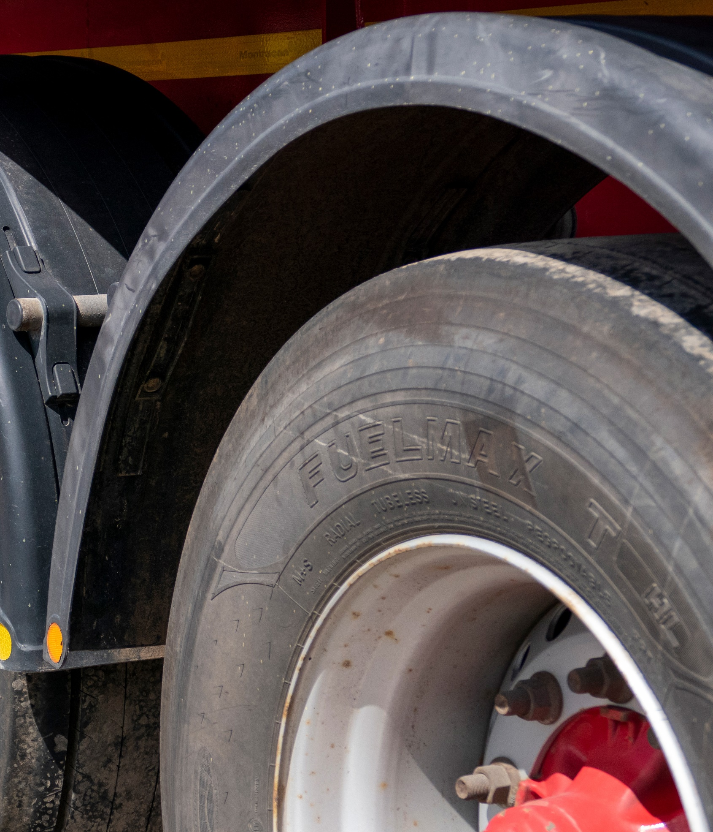

Vehicles and drivers What we know
Engine performance
Heart rate
Fuel consumption
Diet
Asset tracking
Lifestyle
Body condition
Body condition
?
Wear and tear
✓
Mindset
Maintenance history
Medical history

Slide 5


Vehicles and drivers Maintenance
First use inspection
Annual declaration
Walkaround check
Periodic medical
Periodic maintenance
Eyesight check
Regular servicing
Drug and alcohol test
?
Safety inspection
✓
Licence check
Annual test
????

Slide 6



Driver roadworthiness
To help ensure road risk is effectively managed and road safety is maintained, driver health can be structured into three areas
Physical health
Mental health
Moral health
Body condition
Illness, injury, disease or disorder
State of the mind
Emotional, psychological or social
Ethical conscience
Attitude, values or beliefs

Slide 7






Driver physical health
84% Overweight or obese
87% Physically inactive
35% High blood pressure
31% Suffer anxiety
15% Suffer depression
Sleep duration
40% <7hrs sleep
45% <6hrs sleep
Physical activity
78% inactive
20% >8hrs sitting
78% >10hrs sitting
Sitting time
40% overweight
49% with obesity
Weight status
Commercial driver life expectancy is 15 years less than the average population
An underserved, high-risk population urgently needing assistance to prevent an explosion of type 2 diabetes and cardiovascular disease
48% pre-hypertensive
30% hypertensive
Blood pressure
Bad cholesterol
44% with high LDL Cholesterol
Based on data collected from 382 drivers, 99% male, average age 48 years (Clemes et al. 2022)
Notes:
Service/inspection records
Brake efficiency
Engine performance
Emissions tests
Tyre wear/pressures
Telematics data
Fuel consumption
Idling time
Mechanical faults/repairs
Accident damage/repairs
CCTV data

Slide 8
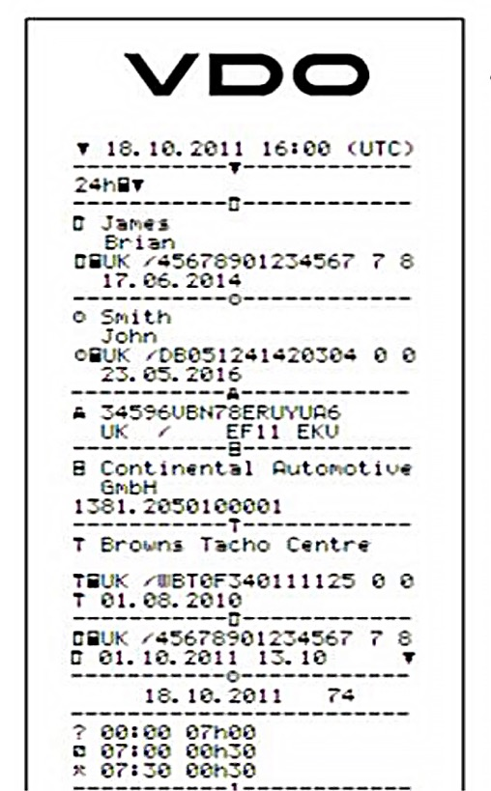
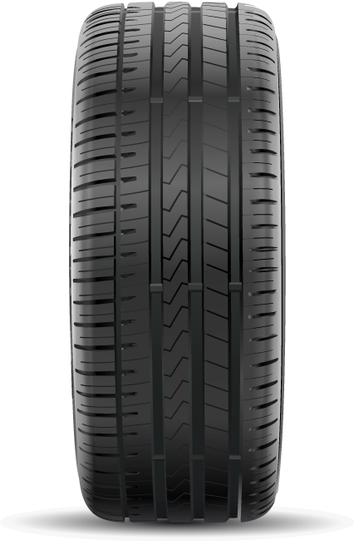
Policy versus law
Minimum tread depth
< 3.5 tonnes 1.6mm
> 3.5 tonnes 1mm
75% of the tyre width around the full circumference
Maximum daily driving
< 3.5 tonnes 10 hours per day
> 3.5 tonnes 9 hours can be increased to 10 hours twice a week
Remaining pattern must be visible

Slide 9

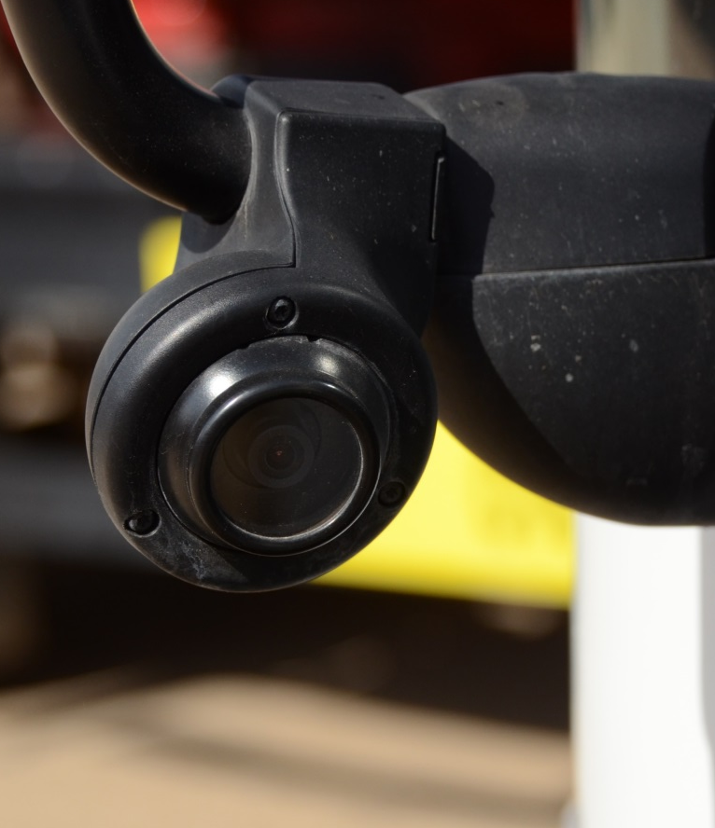
Vehicles and drivers Vision standards
£00
£2000
£25

Slide 10
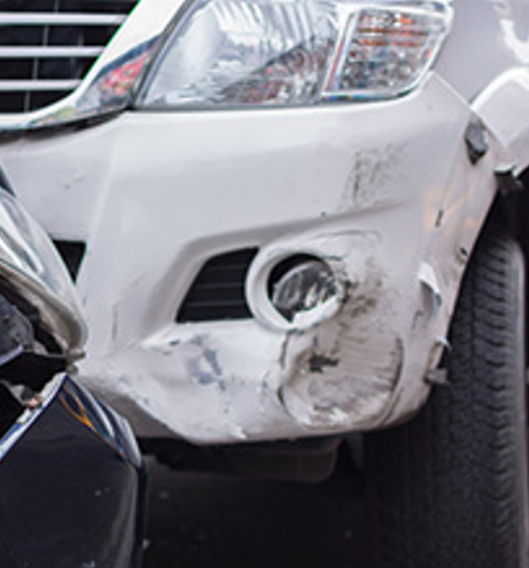

Vehicles and drivers Post collision

Slide 11
Moral fitness Operating benchmark
Best practice
A level recognised to be best in class across the industry
Good practice
An established industry norm with an acceptable outcome
Legal compliance
Ok practice where the margin for error is scalpel thin
Bad days

Slide 12
Tip of the iceberg What we know about drivers
Regulations
Road risk
Customer conflict
Operational stress
Other road users
Work conditions
Money
Job security
Family
Relationships
Attitude
Drugs
Alcohol
Physical fitness
Self esteem
Diet
Emotional fitness
Stress
Depression
Mood disorders
\
Fitness
Eyesight
Sleep disorders
Fatigue

Slide 13


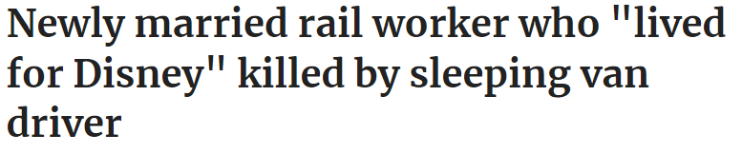

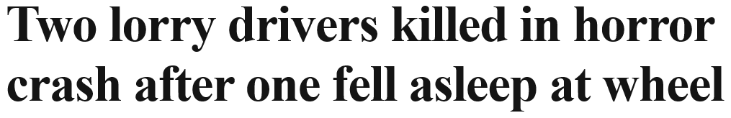





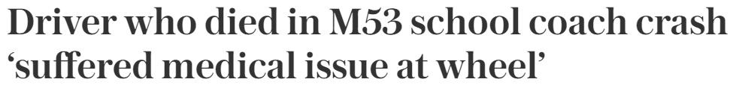
In the headlines

Slide 14
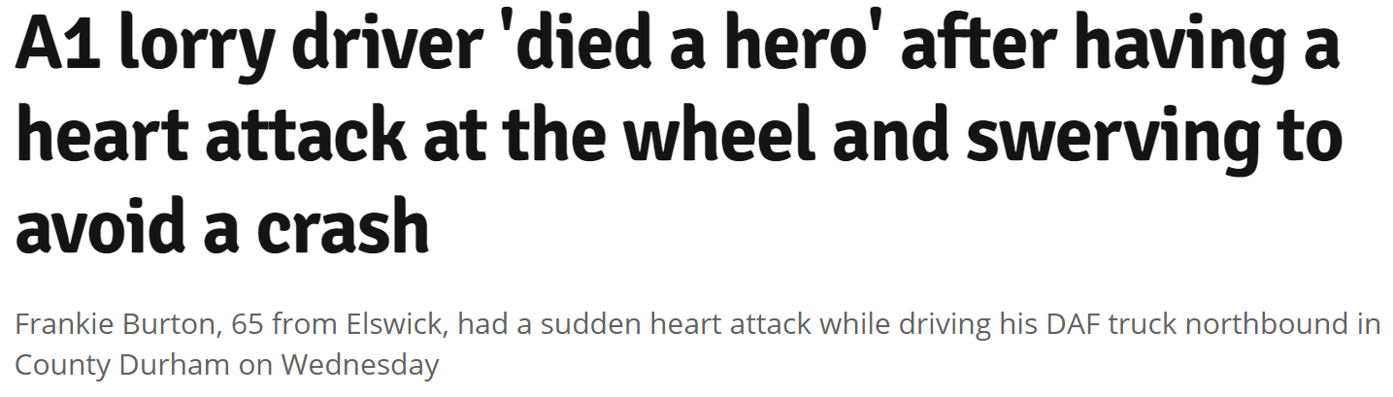
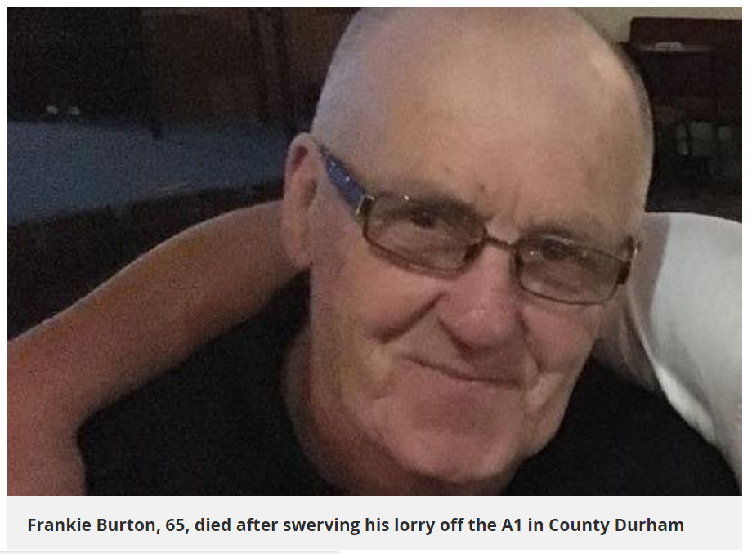
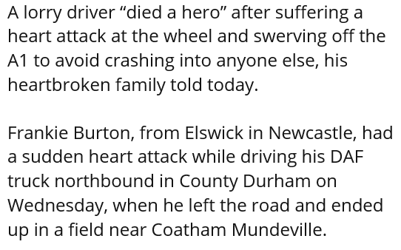

Slide 15





Today’s takeaways
Know your drivers
Prioritise resources
Review your policies
Appreciate
Personal circumstances, family situation, health issues
Focus
Time, budget and management on the areas of most risk
Ensure
Organisational commitment support your objectives

Slide 16

Guide to maintaining roadworthiness
of road traffic collisions are caused by human error
95%
Guide to driver roadworthiness
Commercial goods and public service drivers
Human error
95%
Vehicle failure
Environmental factor
5%
Managing road risk through driver health and wellbeing

Slide 17





glen@thedriverhandbook.co.uk

