Slide 1



Highways England
Supply Chain Masterclass

Slide 2
Housekeeping
Please turn your mobile phones to silent
No planned fire drills, if the alarm does sound venue staff will direct you to the nearest assembly point

Slide 3


Slide 4


Slide 5
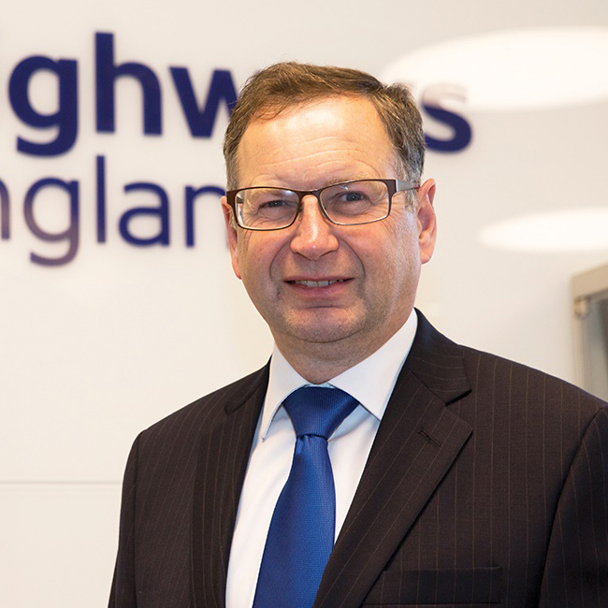
Jim O’Sullivan
Chief Executive
Highways England

Slide 6

James Haluch
Managing Director
Amey Highways

Slide 7
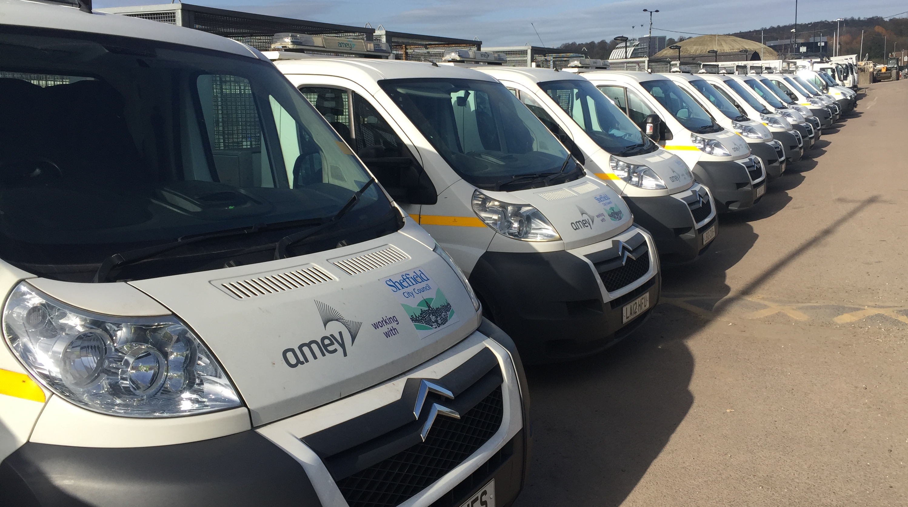
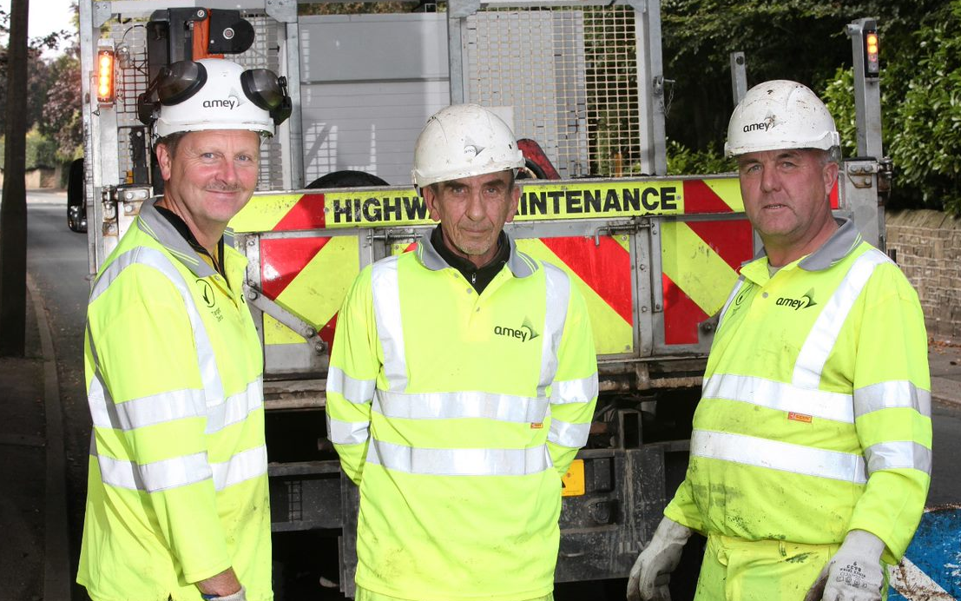

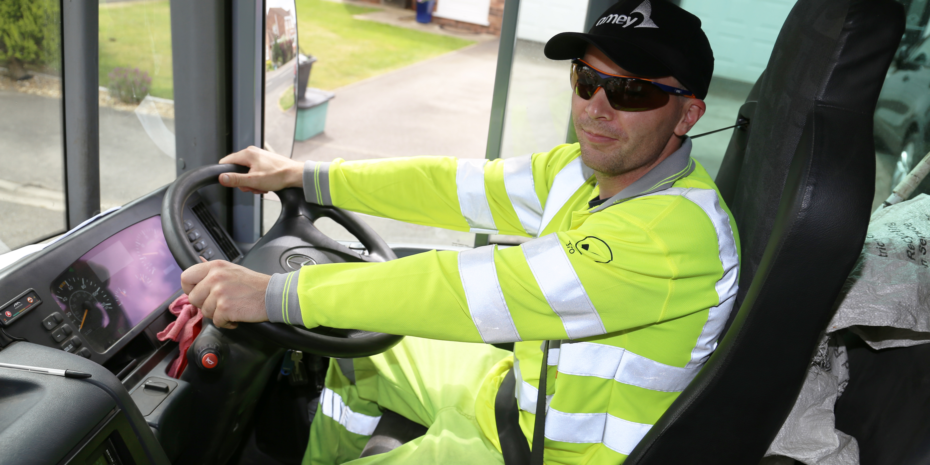
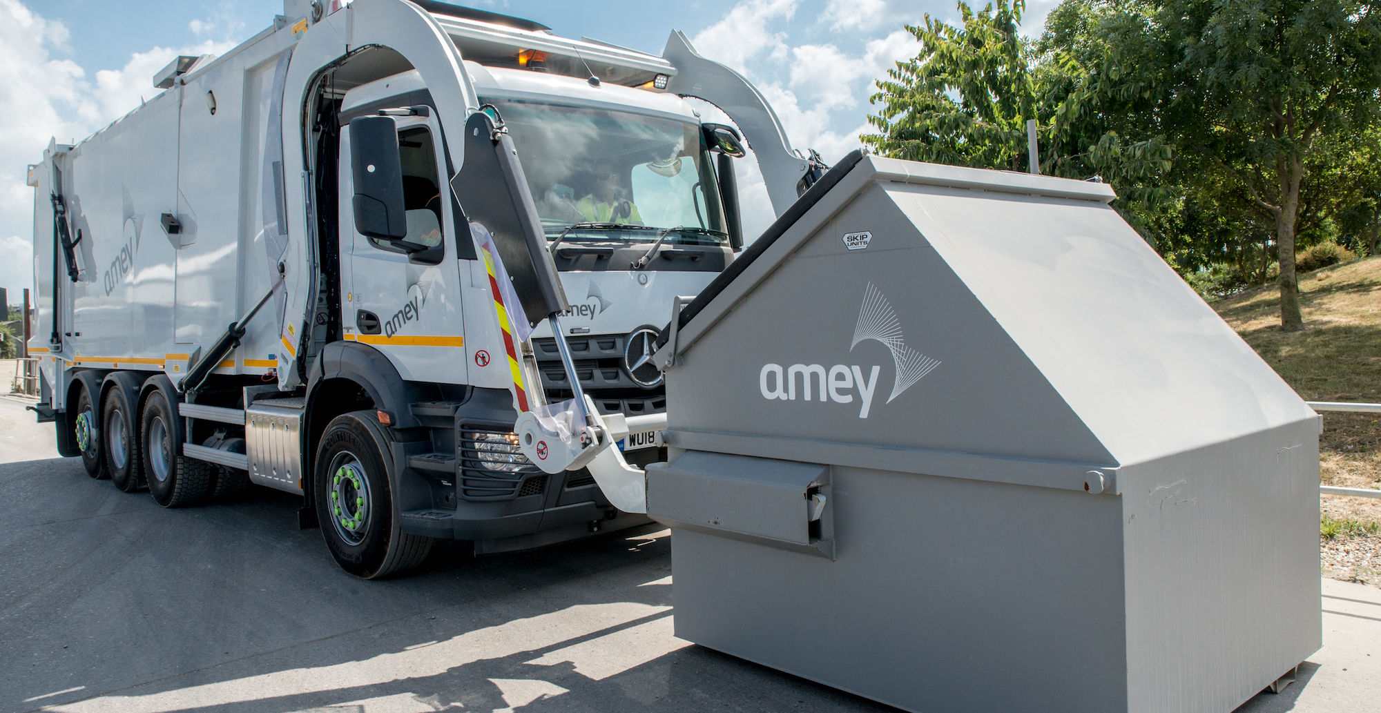
7

Slide 8
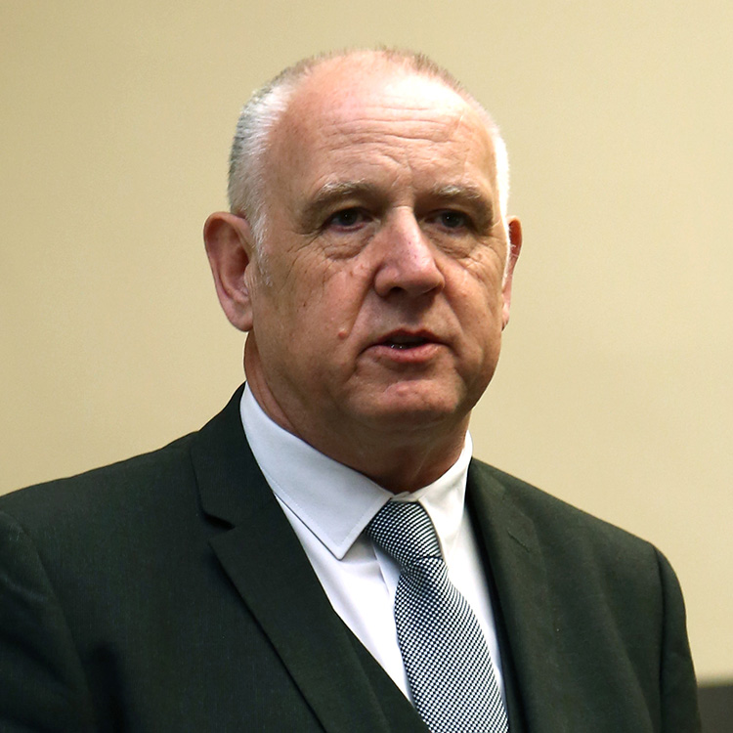
John Lawrence
Champion Programme Manager
Driving for Better Business

Slide 9
What is Driving for Better Business?
Driving for Better Business is Highways England’s approach
to delivering improvements in work-related road safety.
^{Our Aim}
To improve awareness of work related road safety, employers’ duty of care and employees’ responsibilities.
^{Our Ambition}
To bring about a radical change in how businesses think about work-related road safety.
^{Our Mission}
To improve the levels of compliance for all those who drive or ride for work and to demonstrate the significant business benefits of managing work-related road safety more effectively.
The programme is completely FREE to join and access

Slide 10

What is Driving for Better Business?
The programme is supported by government, regulatory bodies and trade associations:

Slide 11
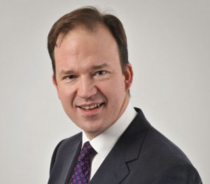

Government Support for DfBB
“The Highways England Driving for Better Business Programme supports the British Road Safety Statement in raising awareness of the importance of work-related road safety.”
“Road safety is not just a matter for government and the public sector. Is it an issue that requires support from the private sector, and that means businesses making sure they are compliant with current legislation.”
Jesse Norman, MP
Parliamentary Under Secretary of State
for Roads, Local Transport and Devolution
The DfT Road Safety Statement (2015)
Key government priorities include:
Reduction in work-related road collisions
Faster uptake of safer vehicles – AEB
Greater enforcement against non compliance

Slide 12



Why manage work-related road risk?
LEGAL
MORAL
FINANCIAL
Responsibility
to manage WRRS
under H&S law
Duty of care to
Employees
44,000 casualties p.a.
Significant cost savings from managing WRRS

Slide 13
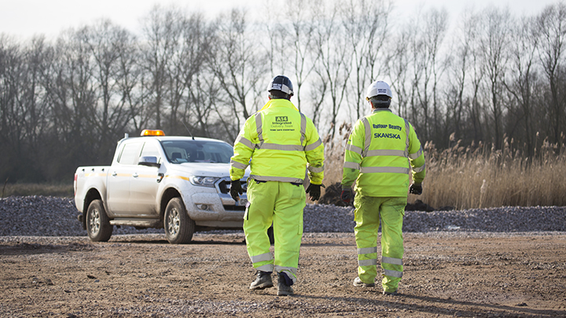

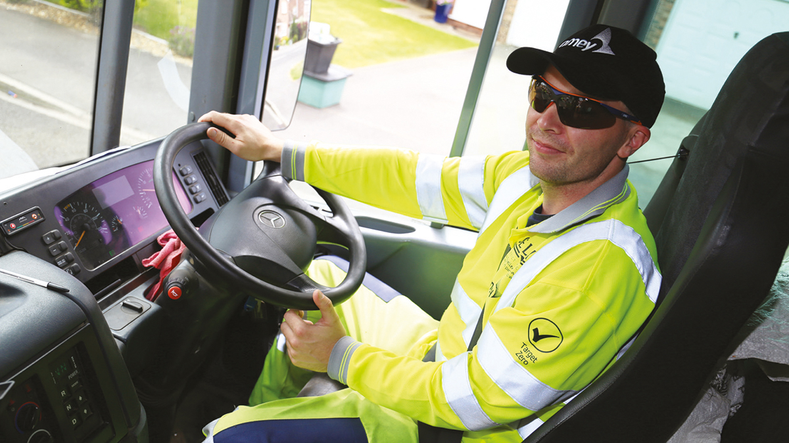

What are Highways England’s expectations?
We want one of the safest supply chains in the world!
Therefore we expect our supply chain to:
Demonstrate they behave and operate compliantly
Go beyond minimum standards and pursue best practice
Demand and expect the same of their own supply chains

Slide 14
The aims of this session
To assist contractors in making the DfBB commitment and going on to achieve Business Champion status
To dismiss fears or myths of what it takes to become a Champion
To demonstrate the process and provide examples of what is required
To go through an example case study of a DfBB Champion
Explain the benefits of being a DfBB Business Champion
Notes:
Tier 1’s may be at different stages – from not engaged at all to already achieved Champion status

Slide 15

The journey – how do you get there?
STEP 1
Engage with DfBB
STEP 2-5
Most responsible contractors will
already have these in place
STEP 6
DfBB Commitment
STEP 7
Good practice
Become a Champion

Slide 16
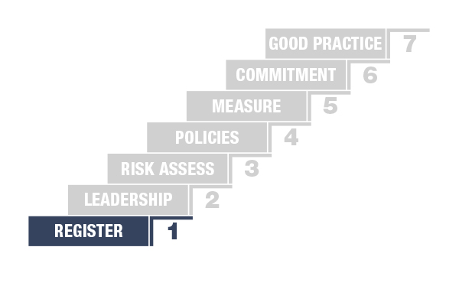
Step 1: Engage with DfBB
Go to www.drivingforbetterbusiness.com
Register with your email address
Gain access to all the resources
Once registered we will assist you on your journey to being a Champion

Slide 17
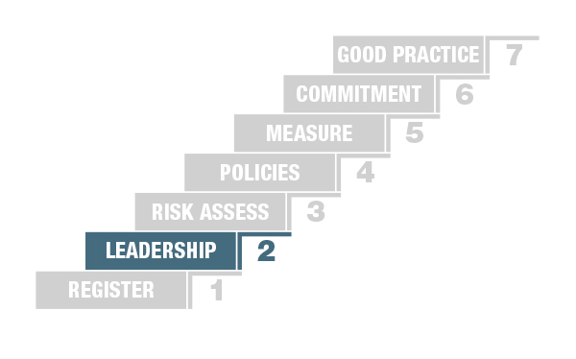
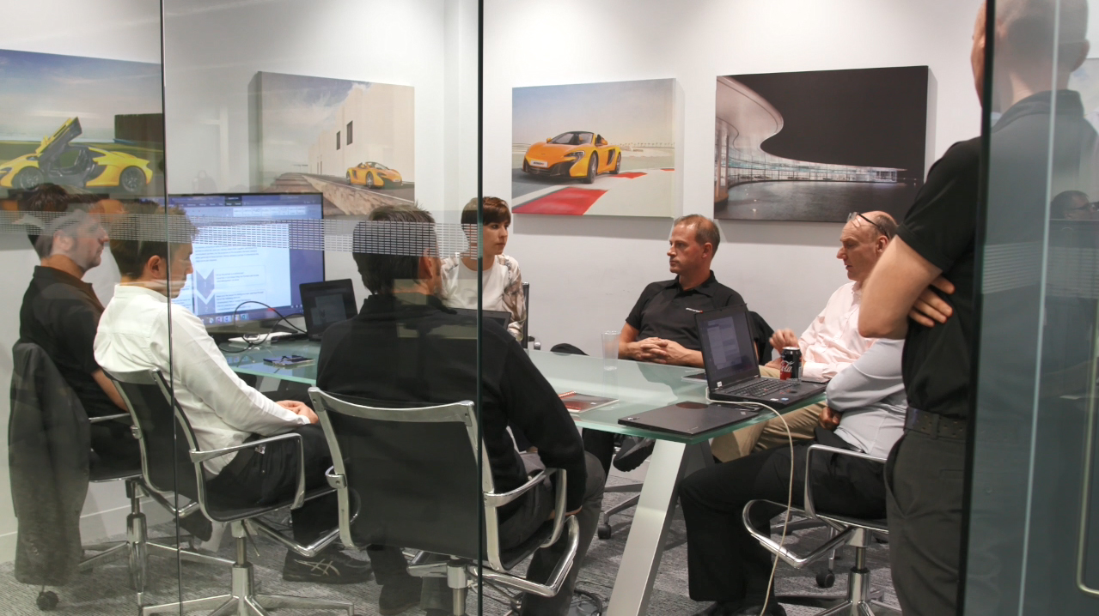
Step 2: Top down leadership
Is essential to demonstrate this
Support and commitment by the business and the senior management
This is important – we are not just ticking boxes

Slide 18
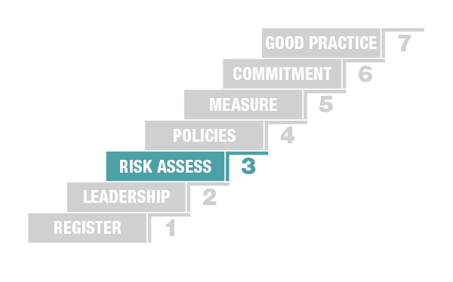
Step 3: Risk assess driving at work activities
Your own risk assessment or free online risk check from DfBB
- Company, driver, vehicle, journey
All fleet
- Company cars, Vans
- Light & Heavy Commercials
- Grey Fleet, Any others
Use the results to identify any gaps

Slide 19
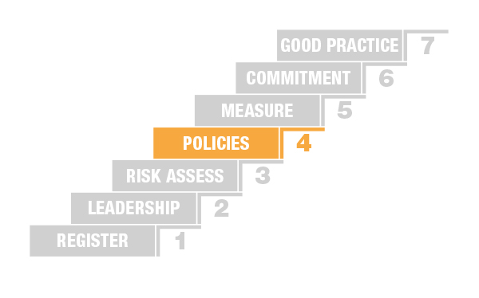
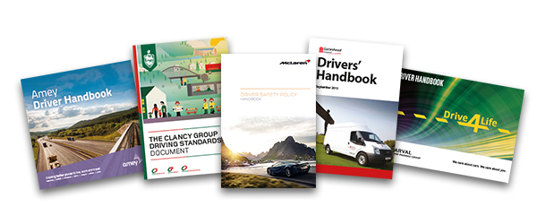
Step 4: Driving at work policies
Check your policies are current
- Driving at Work Policy
- H&S Policy
- Car Policy
Be prepared to provide any copies to HE
View our Champion policies

Slide 20
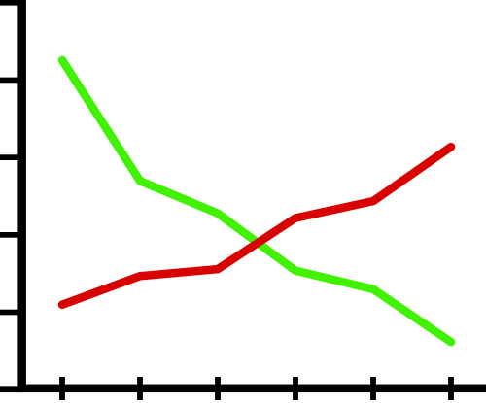
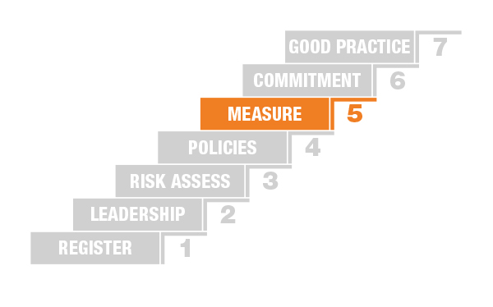
Step 5: Measuring & monitoring fleet activity
If you are not measuring you are not managing – identify and act on trends
Collison data/stats
Fuel & emission data
Driver licence checking
Training strategies
Telematics data
Fleet Utilisation
Any other info or data

Slide 21
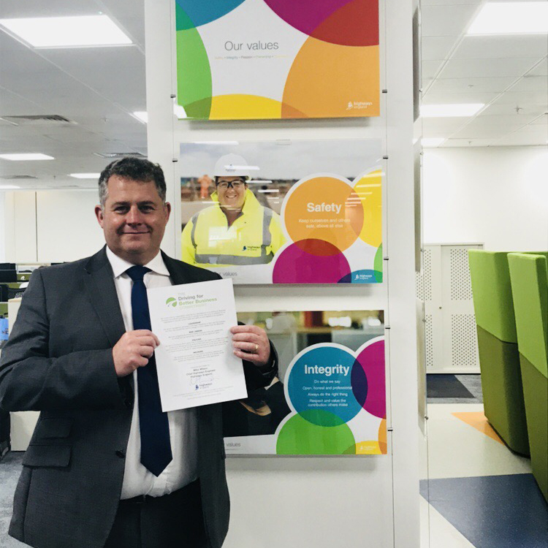
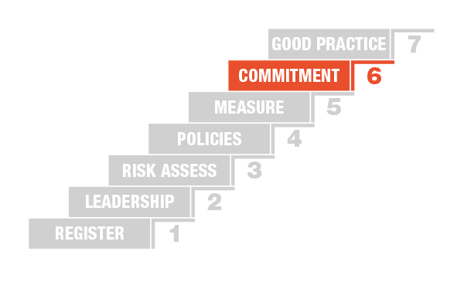
Step 6: Make the DfBB Commitment
Confirmation of Steps 2-5
Management Awareness
Risk Assessment
Driving for Work Policy
Record Keeping
This is the legal minimum to comply
with legislation and HSE guidance.

Slide 22
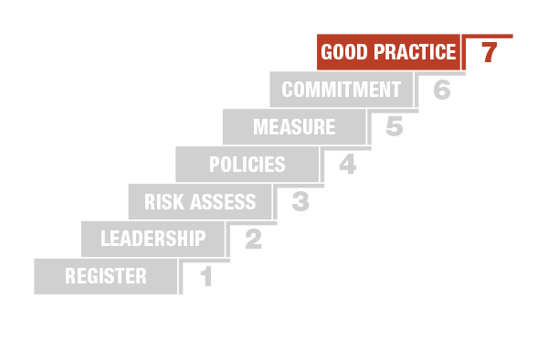
Step 7: Achieving Champion Status
Manage those who drive for work to an extremely high level
Demonstrate that this approach has benefitted their business
Case studies should be held up as an inspiration
for other ambitious employers to copy
Case study main aims:
- Showing the way they operate their fleets
- Share policies with DfBB community
- Demonstrate the business benefits
Promote DfBB to your networks
and supply chains

Slide 23
Case study preparation
Company profile
Fleet dimensions
Compliance conformation
Company aims and core values
Nature of driving activities
Statement from CEO or Senior Director
Quote from WRRS/Fleet Manager
WRRS Policies
Any additional WRRS Activities
Business benefits examples
Awards achieved or accreditations for your company or staff
Provide Driver Handbooks and/or Policies
Notes:
Templates are available
We are available to help

Slide 24


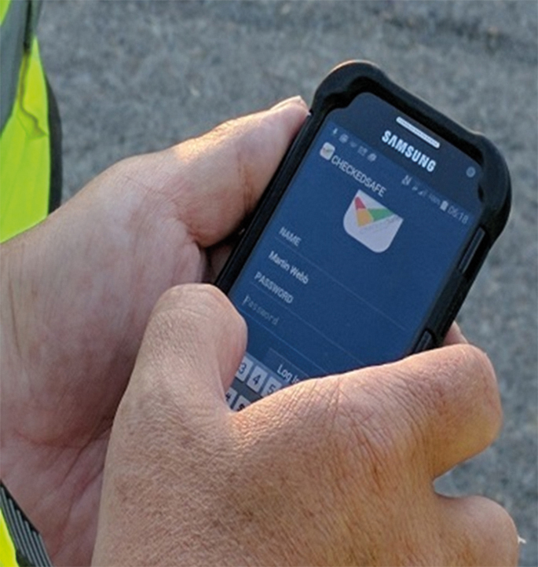
Example Case Study
ACTIONS
Leadership – James Haluch
Policies and driver handbooks
Licence Checks
Driver Training
Daily Vehicle Checks
Telematics, cameras, reverse alarms
Fleet & Plant Conference
Driver Safety Films
Supply Chain Control

Slide 25
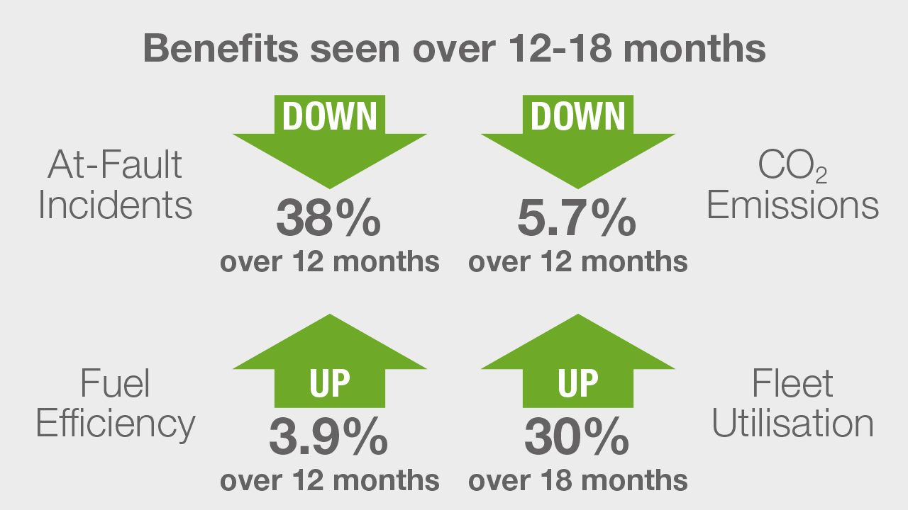
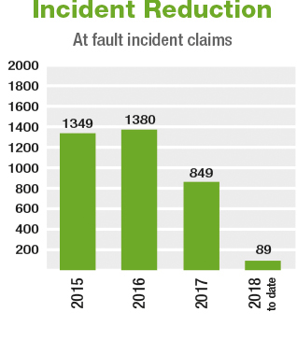
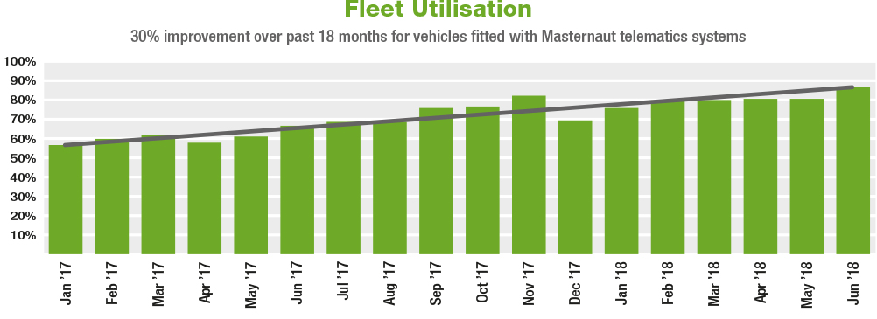
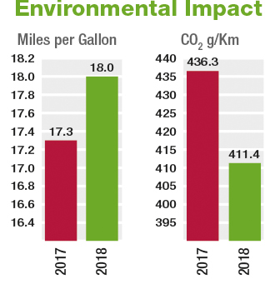
Example Case Study
BENEFITS

Slide 26
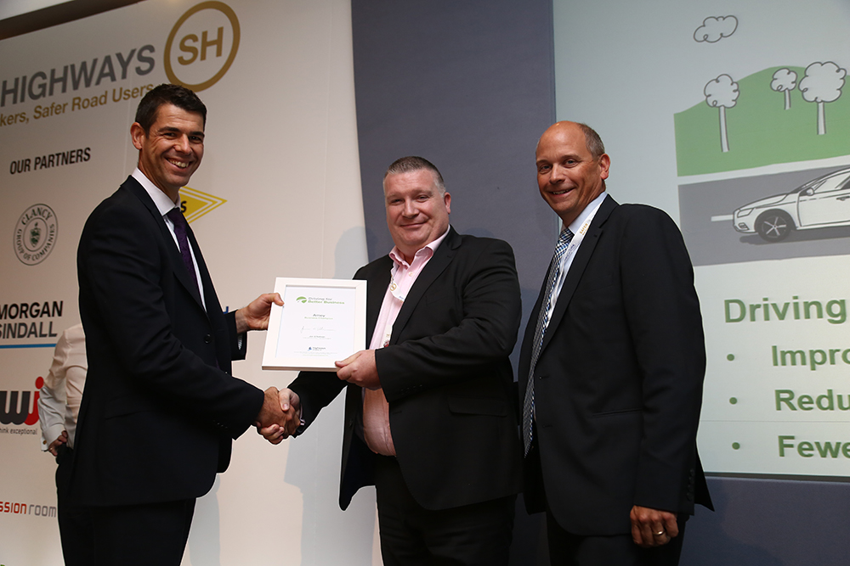





Benefits of being a DfBB Champion
Champion certificate
from Highways England
Case study on the
DfBB website
Case study promoted
on social media

Slide 27
Next Steps
Refer to workbook back page
Identify who needs to be involved and assign tasks
Share resources – www.drivingforbetterbusiness.com/he-supplychain
Engage with the programme – register on the website
Ensure your business is currently compliant
Work towards becoming a Champion
Promote DfBB through your own supply chain

Slide 28
Thank you
Any questions?

